Slide 1
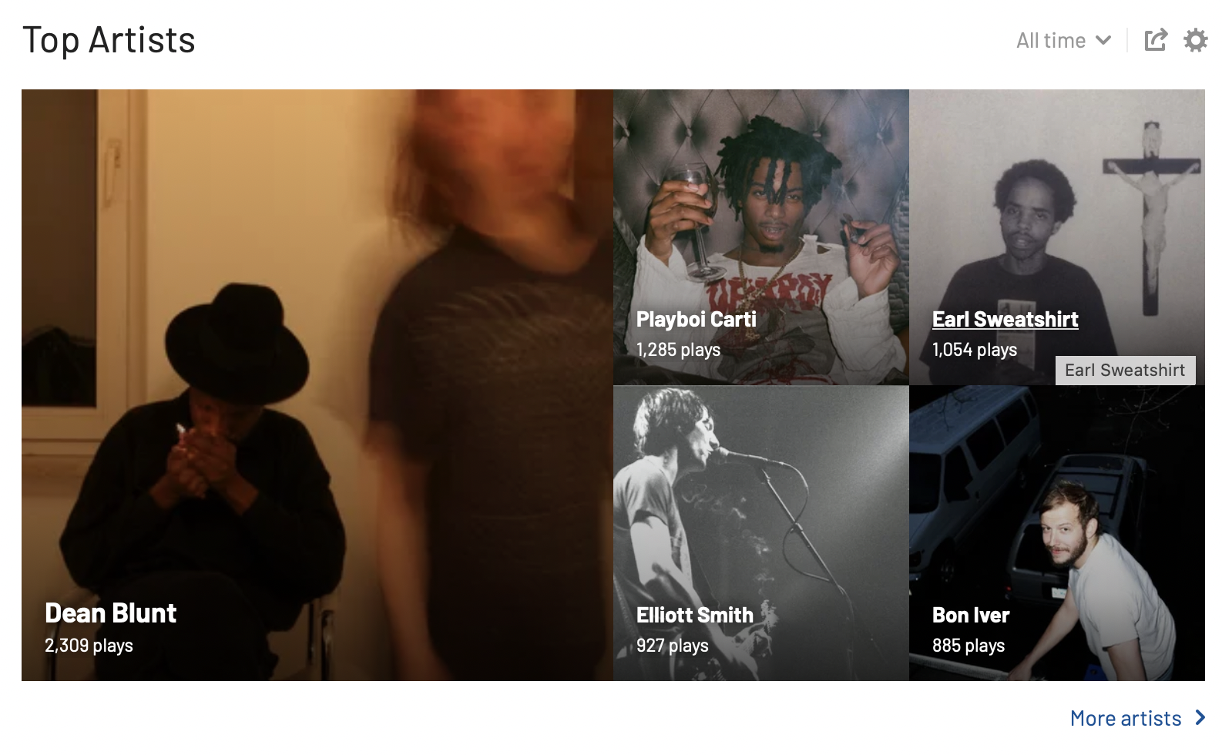

32

Slide 2

Virksomhedsbesøg ved The Tech Collective
Mandag d. 25/11 kl. 09 – 11
Borgergade 111
32

Slide 3



Tableau fundamentals training

Slide 4

Agenda
Introduction to the training & tableau
Connect to data
Basic visualizations
Filtering, dates & maps
Dashboards
Recap of the day

Slide 5






Tableau og de forskellige visualiuseringsformer
Bar chart
Usage: Good at comparing categories and numbers. One of the most used visualisations.
Line chart
Usage: Good for continuous data and when looking at trend over time.
Table
Usage: Good at comparing numbers if you want to have a
lot of information. Note: if too big, it can be confusing.
Filter
Usage: If you only want to look at a part of your data at a time but the user should have the possibility to choose which part.
Dates
Usage: Good at investigating trends, seasonality or YTD KPI’s.
Area map
Usage: Good at comparing geographical locations and looking into geographical patterns.

Slide 6

What is Tableau?
1
Visual
2
Interactive

Slide 7

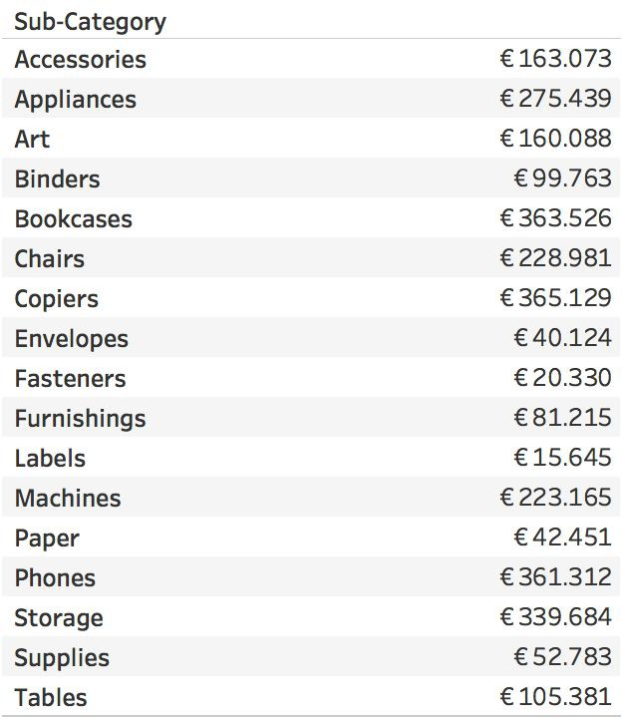
1
Visual
Når I ser listen, skal I råbe svaret højt ligeså snart I ved, hvilken kategori der har flest salg
Name the
sub-categories with the highest and lowest sales
- Chart

Slide 8

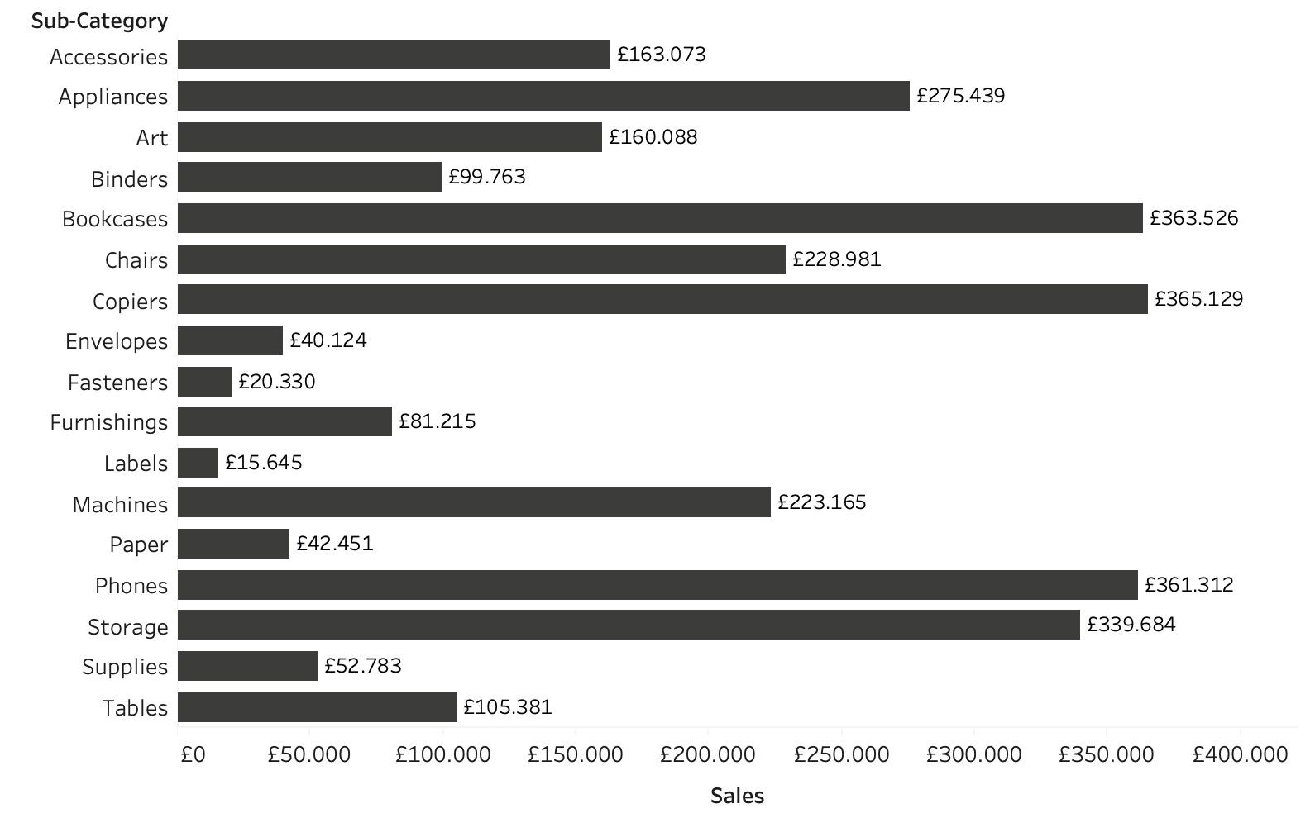
1
Visual
Easier to identify the two sub-categories now?
- Bar Chart

Slide 9

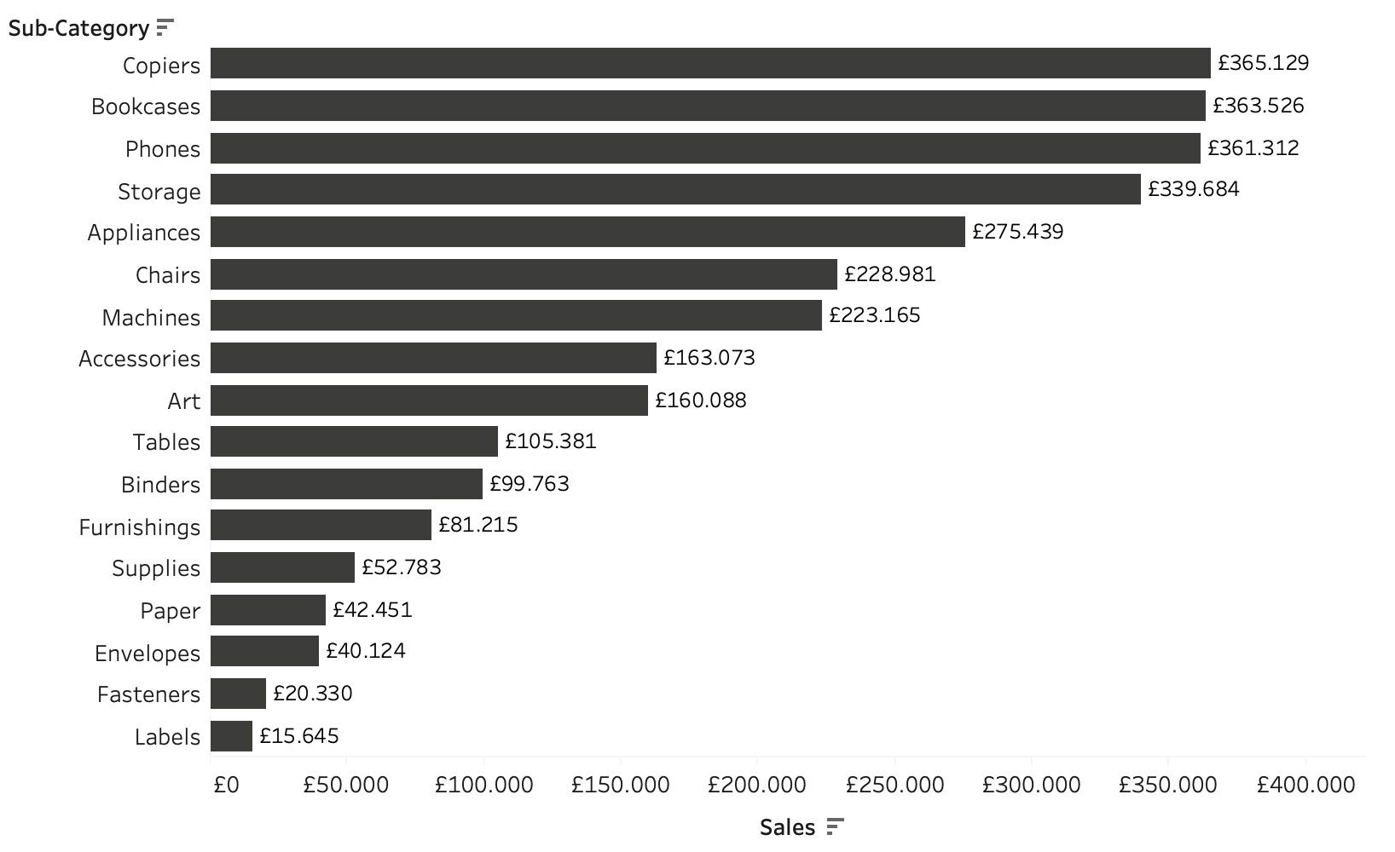
1
Visual
What about now?
- med Sortering

Slide 10

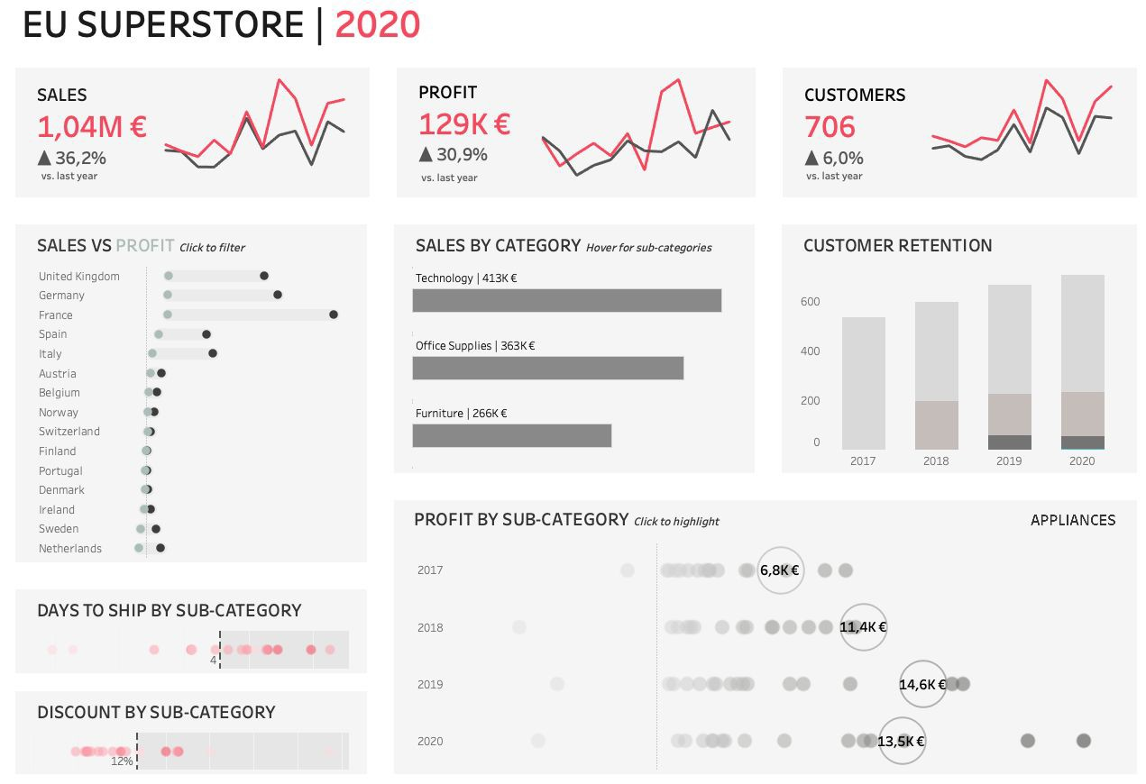
2
Interactive

Slide 11
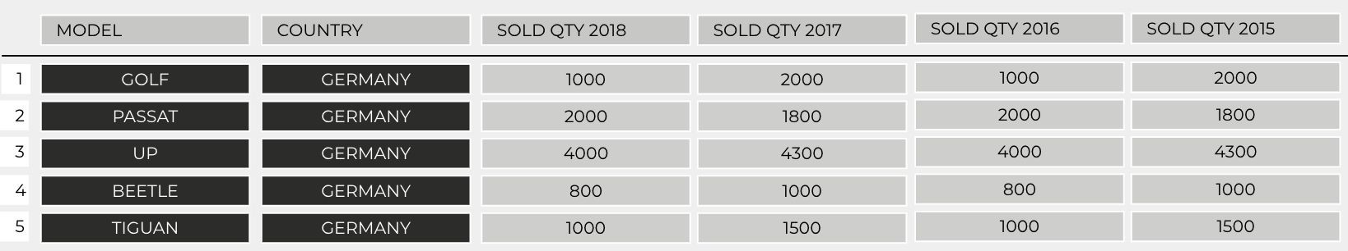

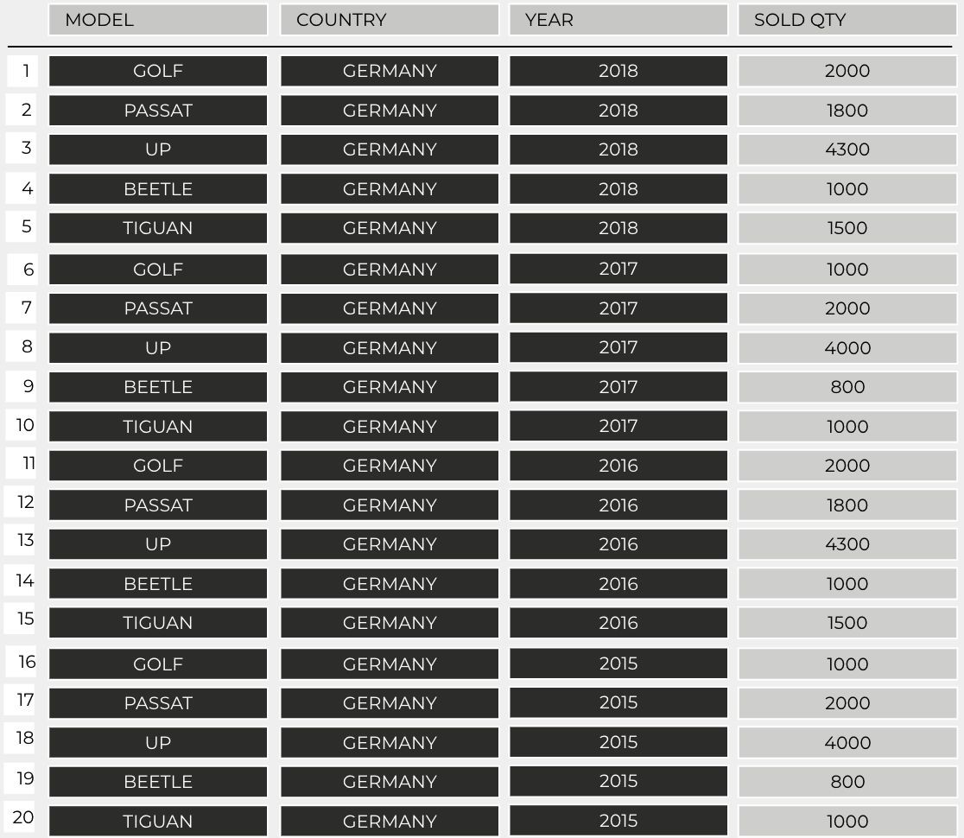

Wide vs. long datasets

Slide 12
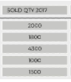
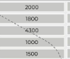
Wide vs. long datasets

Slide 13
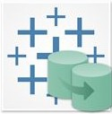


File formats
Data extract
.hyper
Workbook
.twb
Package workbook
. twbx
Extract files are a local copy of a subset or entire data set that you can use to share data with others, when you need to work offline, and improve performance
Tableau workbook files have the .twb file extension. Workbooks hold one or more worksheets, plus zero or more dashboards and stories.
Tableau packaged workbooks have the .twbx file extension. A packaged workbook is a single zip file that contains a workbook along with any supporting local file data and background images. This format is the best way to package your work for sharing with others who don’t have access to the original data
Notes:
Source:
Formater: https://tabsoft.co/3tcPWLn
At gemme: https://help.tableau.com/current/pro/desktop/en-us/save_savework.htm

Slide 14




Data types in Tableau
String
String is text values as category, brand,
Date
Dates as order date, return date
Boolean
Boolean is ﬁelds that can only contain True or False
company
values
ABC
#
T F
Number
Whole number and decimal number is numerical values as sales, proﬁt, quantity
Datetime
Geographic
Geographical places as country, city, airports
Datetime is dates with a timestamp as order date and time
Notes:
What does Boolean means: https://www.computerhope.com/jargon/b/boolean.htm
String:

Slide 15


Let’s get started in Tableau!

Slide 16
Agenda
Introduction to the training & tableau
Connect to data
Basic visualizations
Filtering, dates & maps
Dashboards
Recap of the day

Slide 17
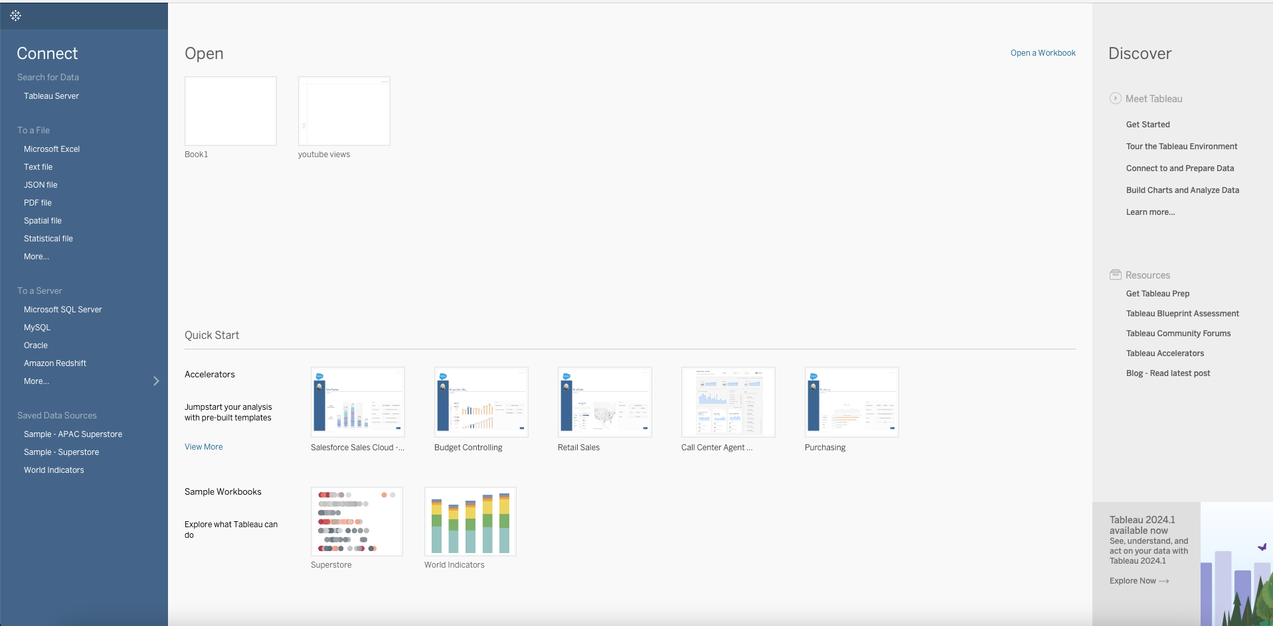
Interface – Start page

Slide 18
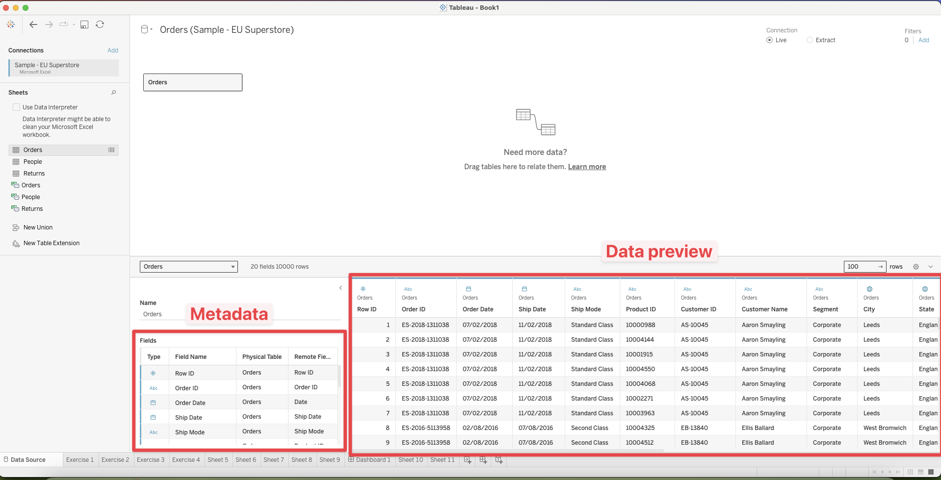
Interface – Import data

Slide 19


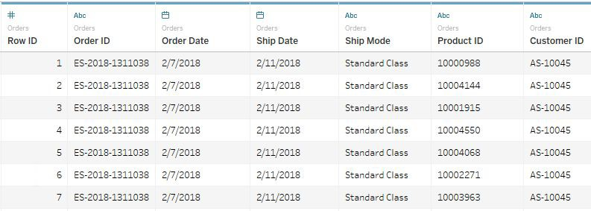
Hands-on: Connect and prepare data
Exercise 1: Why should Product ID be a string?
Step by step:
Connect to Sample - EU Superstore.xlsx → SheetOrders
Change data type for Product ID to a
String (dvs. et felt med text, der ikke kan regnes på)
Rename Date to Order Date
Note: screenshot always shows result, not starting point.
Notes:
Product ID, skal være en STRING, da vi ikke skal regne på det. Det skal bare være en unik identification for hele datarækken

Slide 20
Agenda
Introduction to the training & tableau
Connect to data
Basic visualizations
Filtering, dates & maps
Dashboards
Join databases
Recap of the day

Slide 21
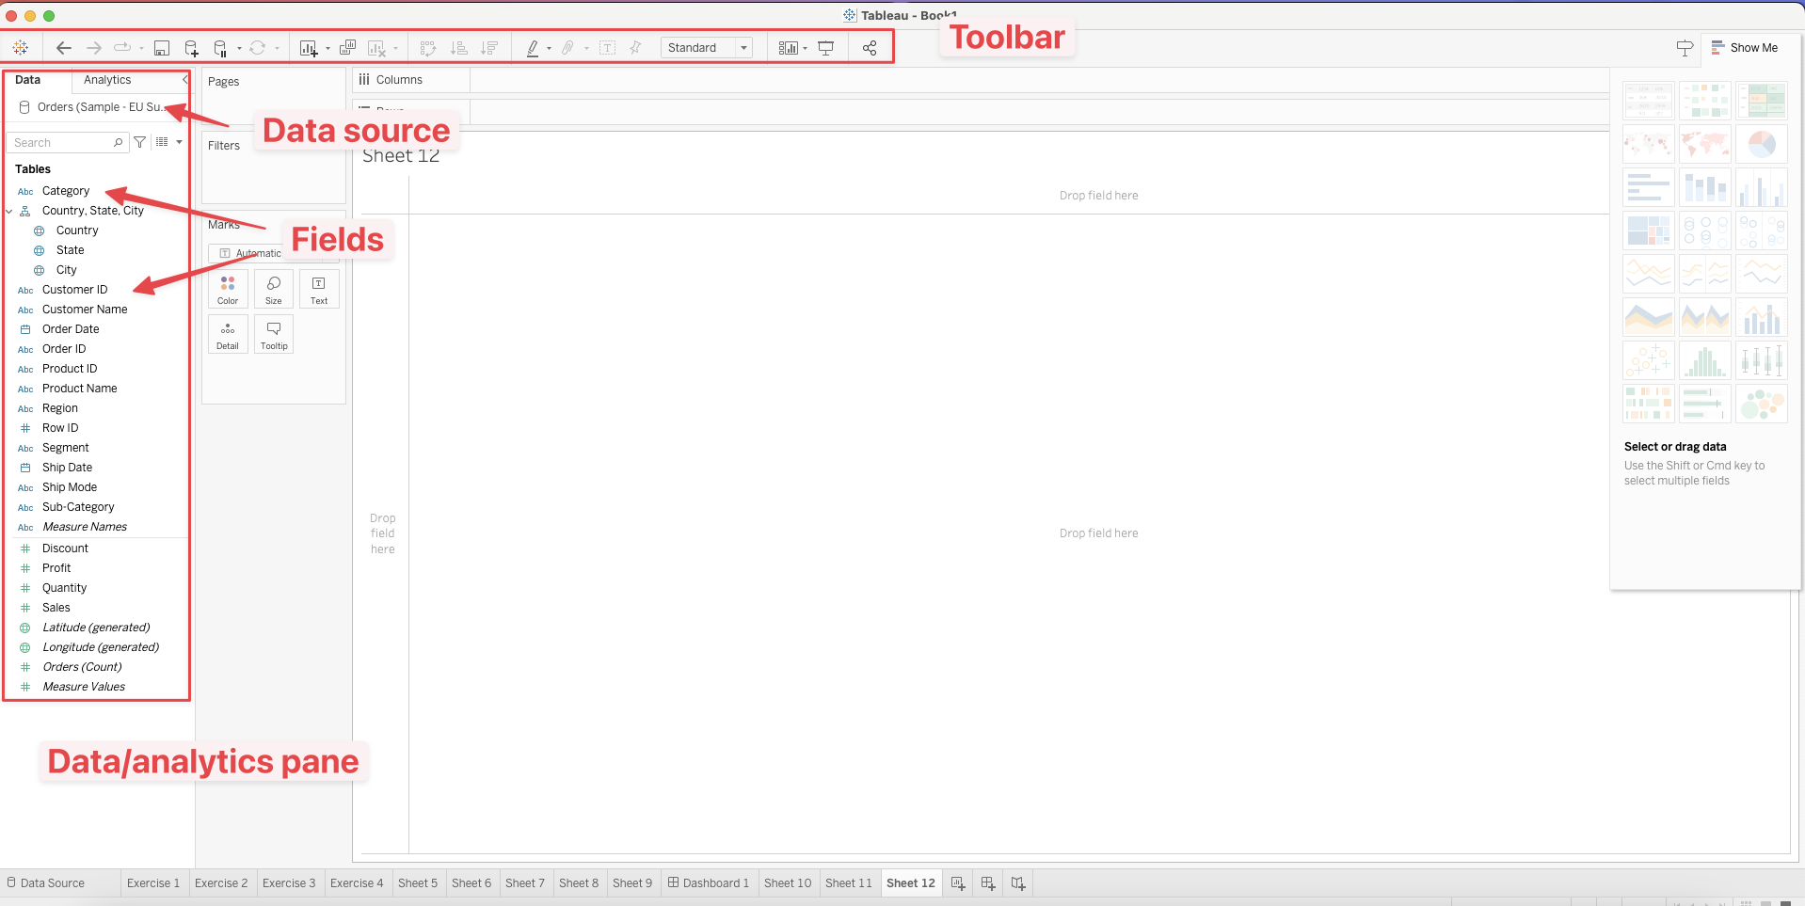
Interface – Visualisation view
Toolbar has quick access to most used functionalities.
Data/analytics Panes. Switch between them by clicking in the top of the pane.
Analytics pane will give you fx average lines or clusters

Slide 22
Dimensions vs. Measures / Dimensioner vs. Mål (Tal)
Measures contain measurable, continous values (Sales, proﬁt, cost etc.)
Written in green
Dimensions contain
categorcial values
(Car names, dates, geo., etc.)
Written with blue
CAR TYPE
PASSAT
GOLF
POLO
UP
SALES
51.599
67.102
34.321
89.102
SUM(SALES) = 242.124

Slide 23
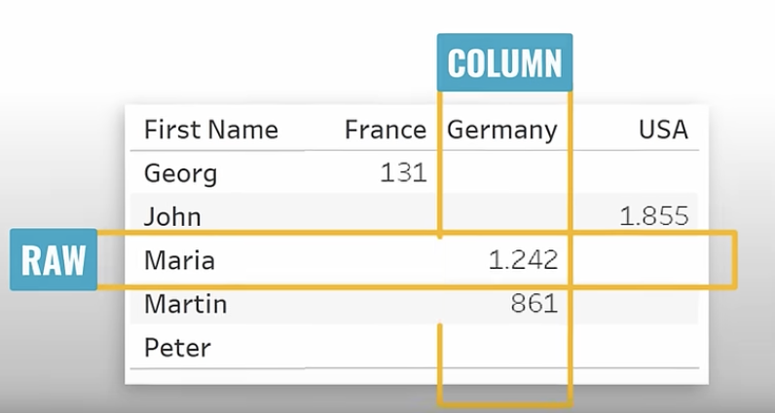
Columns vs rows
Columns and rows decides what should be displayed as columns or rows. It decides how data is visualized on a worksheet.

Slide 24
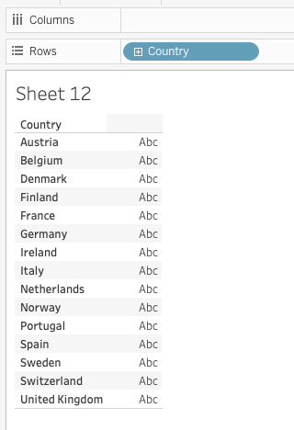
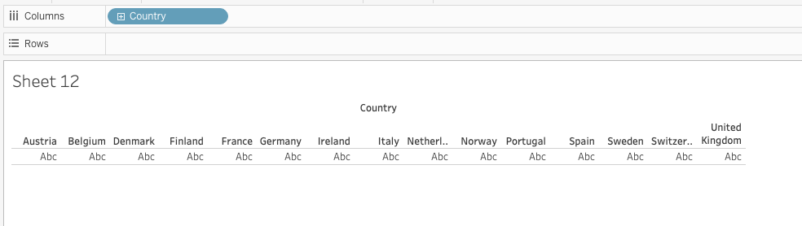
Columns vs rows
Data displayed as rows
Data displayed as columns

Slide 25
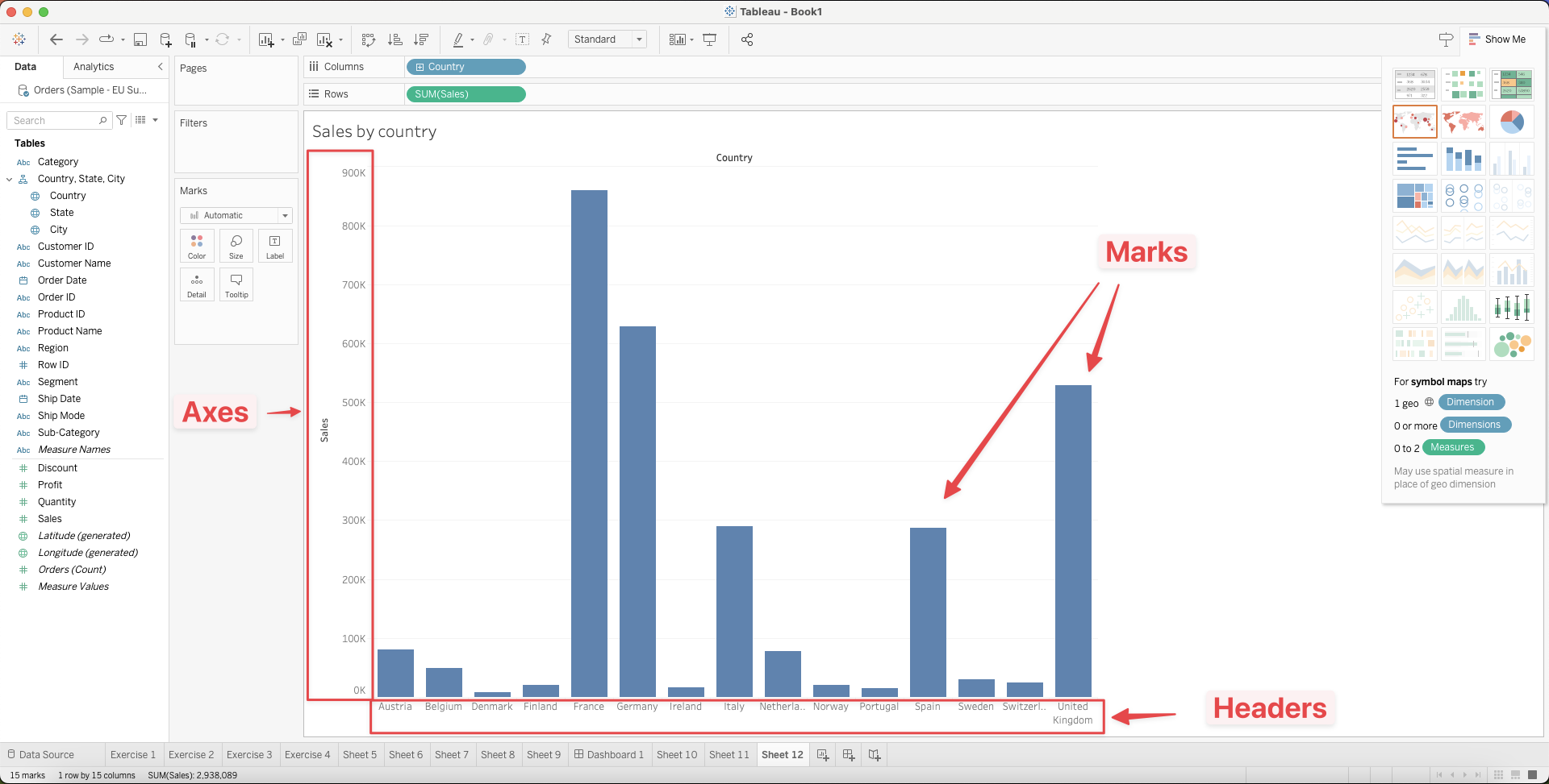
Interface – Visualisation view

Slide 26

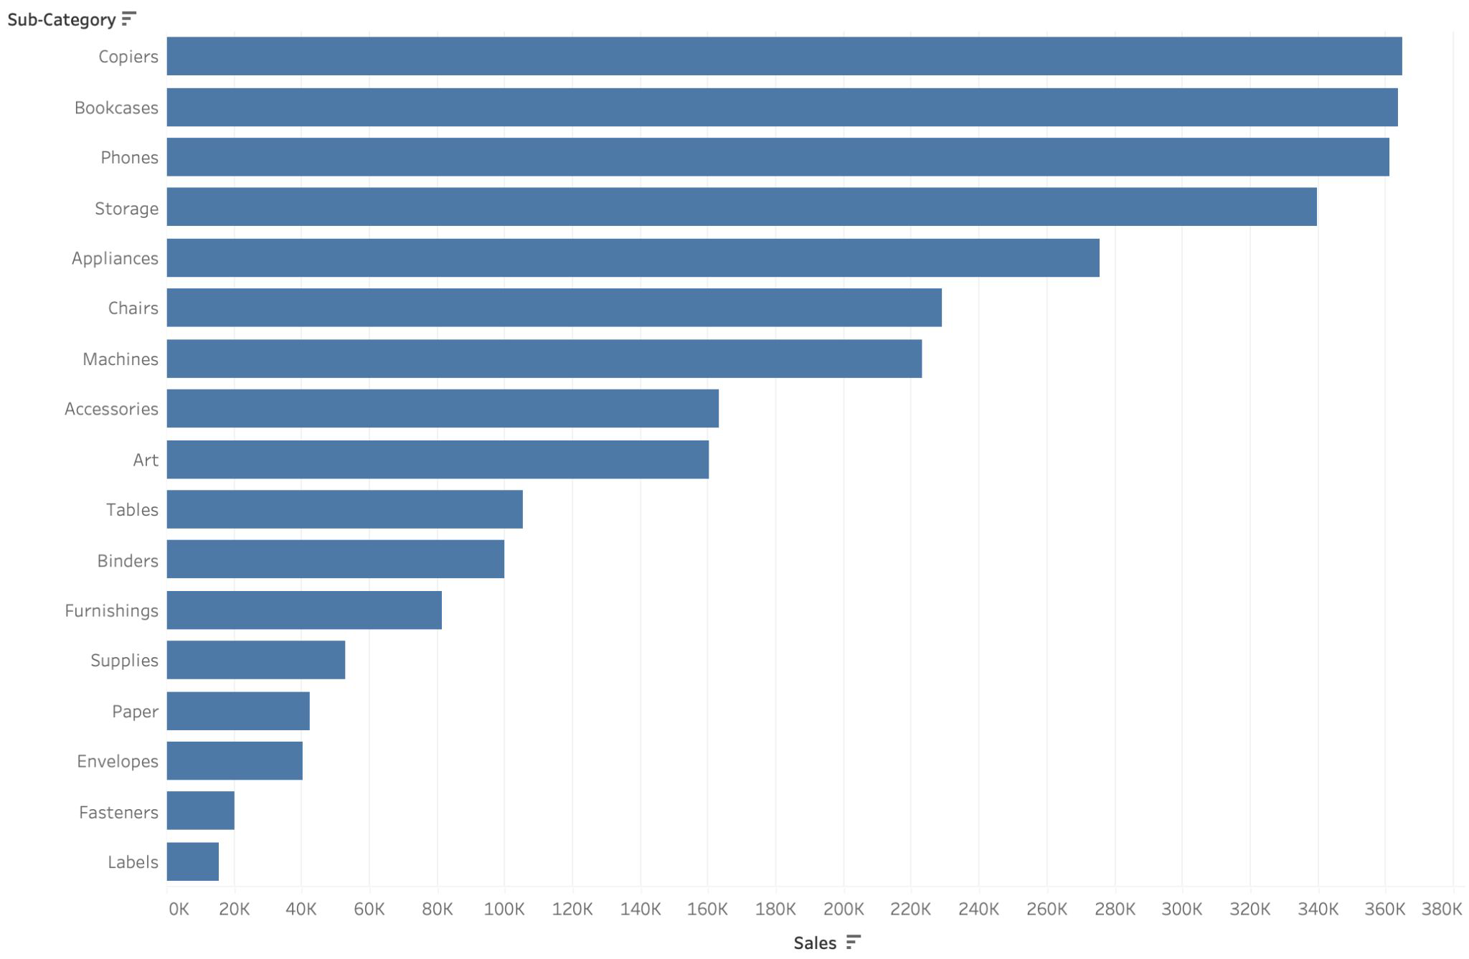
Hands-on: Bar chart
Exercise 2: Which sub-category has the highest sales?
Step by step:
Open a new sheet
Create a bar chart showing Sales per Sub-Category
Sort Sales
Use Entire View

Slide 27
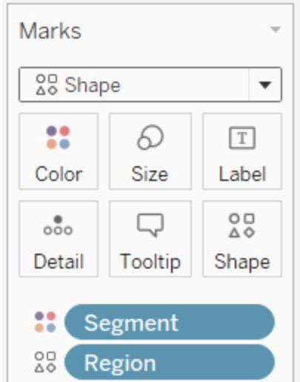
Marks card
Usage
Key element for visual analysis in Tableau
Change type, color, size, shape of marks or add labels or tooltips
32

Slide 28
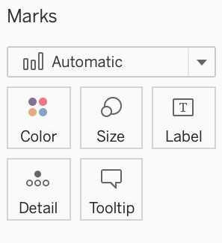
Color
Color palettes
Categorical
Diverging
Sequential
Good to know
You can add your own custom color palette
33

Slide 29

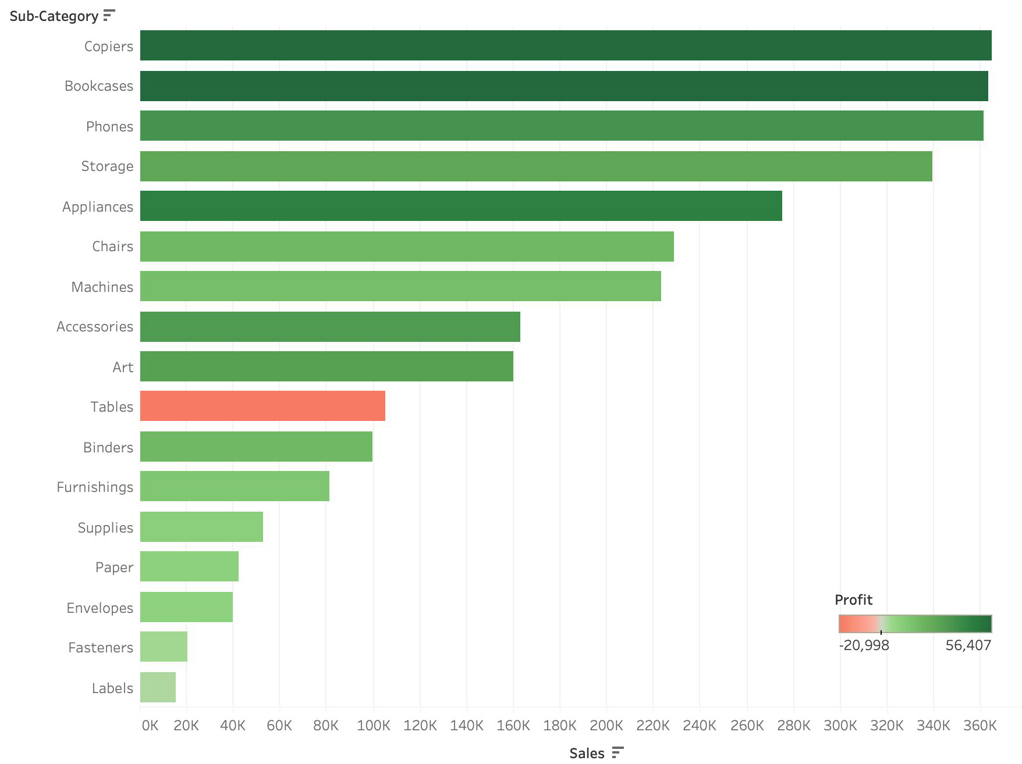
Hands-on: Color and label
Exercise 3: How much do we sell of each sub-category, and do large sales bring higher proﬁt?
Step by step:
Open a new sheet
Create a bar chart showing Sales per
Sub-Category
Color on Proﬁt
Sales on label
Change the color palette to red-green diverging
EXTRA:
6. Sæt relevant Tooltip

Slide 30
Agenda
Introduction to the training & tableau
Connect to data
Basic visualizations
Filtering, dates & maps
Dashboards
Join databases
Recap of the day

Slide 31

Filters
Usage
Filter on a dimension (categorical)
Filter on a measure (quantitative)
Filter with dates
Good to know
You can apply multiple ﬁlters
36

Slide 32

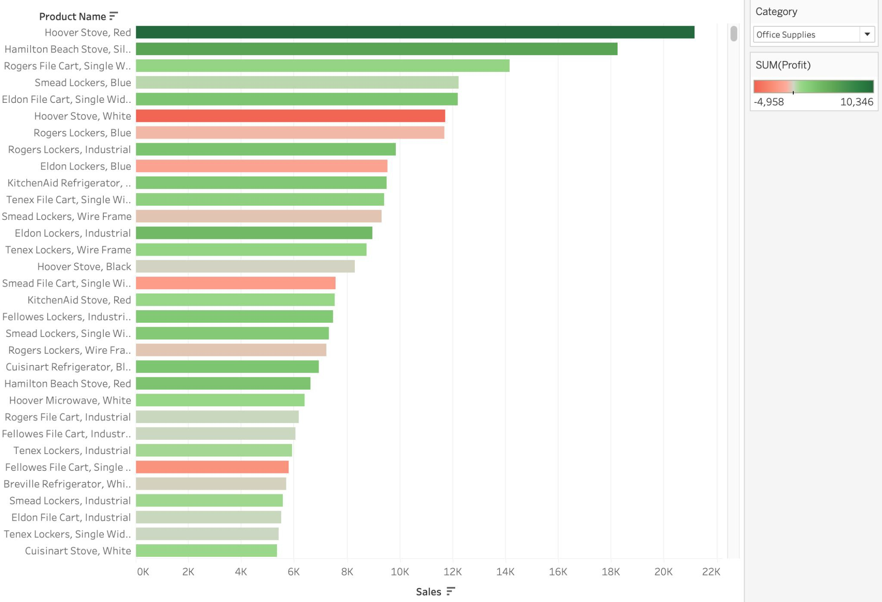
Hands-on: Filter
Exercise 4: Which products sell well within each category?
Step by step:
Open a new sheet
Create a view showing Sales by
Product Name
Label on Sales
Color on Proﬁt, and change the color palette to red-green diverging
Use Category as a ﬁlter
Show ﬁlter and format to a
single-value drop-down

Slide 33
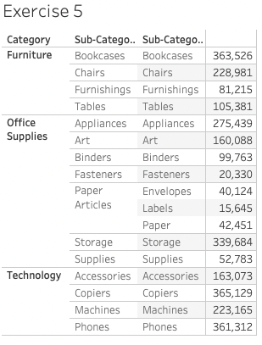
Hands-on: Dates
Exercise 5: Group data
Step by step:
Open a new sheet
Create a table showing how the different products are related

Slide 34
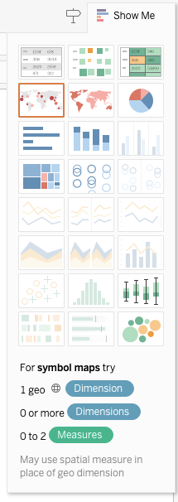
Interface – Visualisation type
To the right of the interface you can click on “Show Me”. Here you can select the visualisation type
In the bottom you can see what requirements you are missing for a specific visualisation type

Slide 35
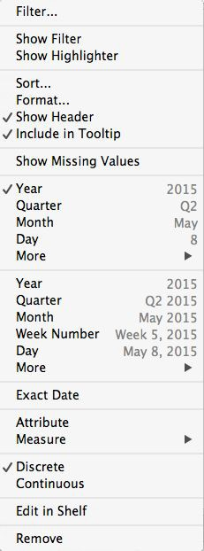


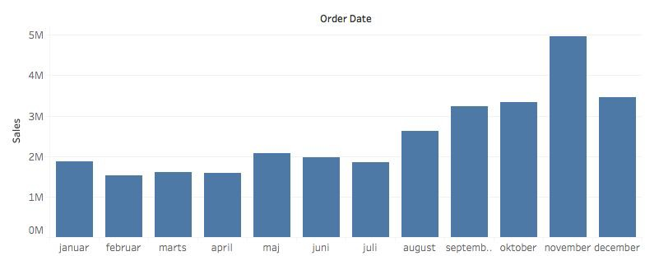
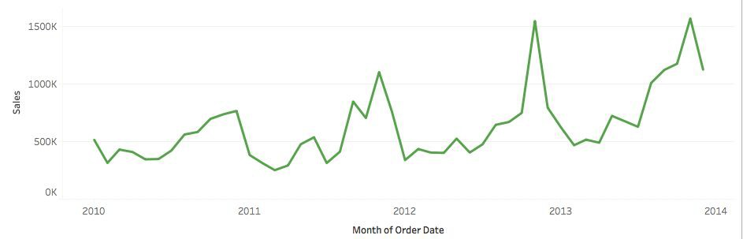
Date parts vs. Date values
Date parts
The actual part of the data: e.g. month, weekday, hour of day
Dimensions default to discrete ﬁelds
Seasonality
Date values
The unique date value: e.g. May 2015, Q1 2017, 2014-01-01
Measures default to a continuous ﬁelds
Trends over time
Den samlede aktivitet i perioden, fordelt på måneder ell. år ell. .. (det er IKKE et gennemsnit).

Slide 36


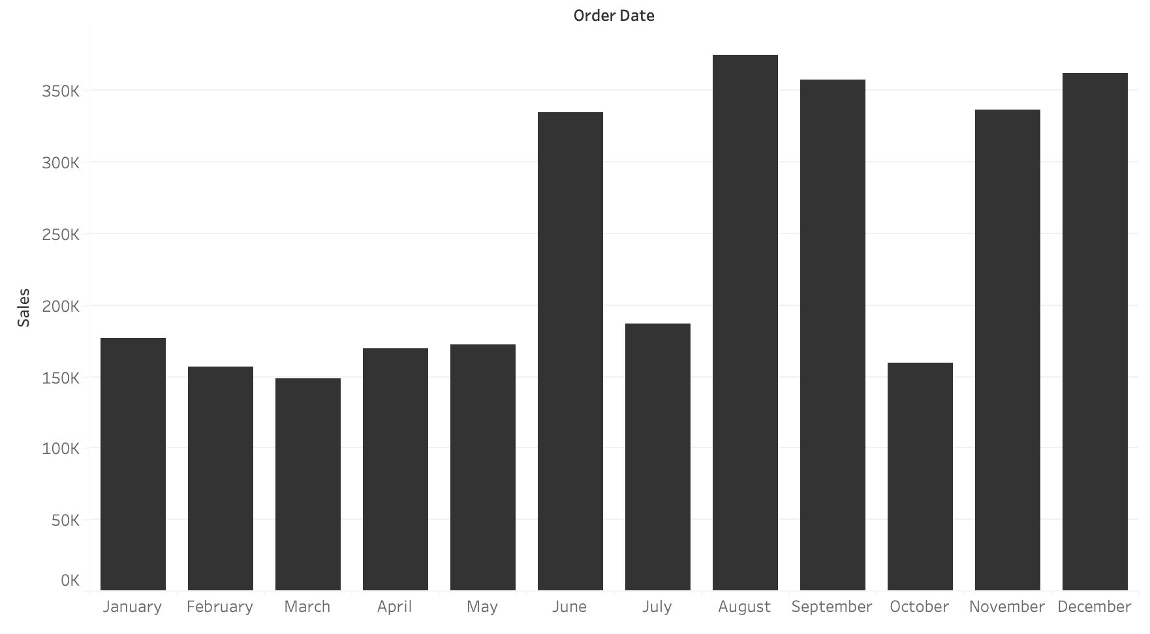
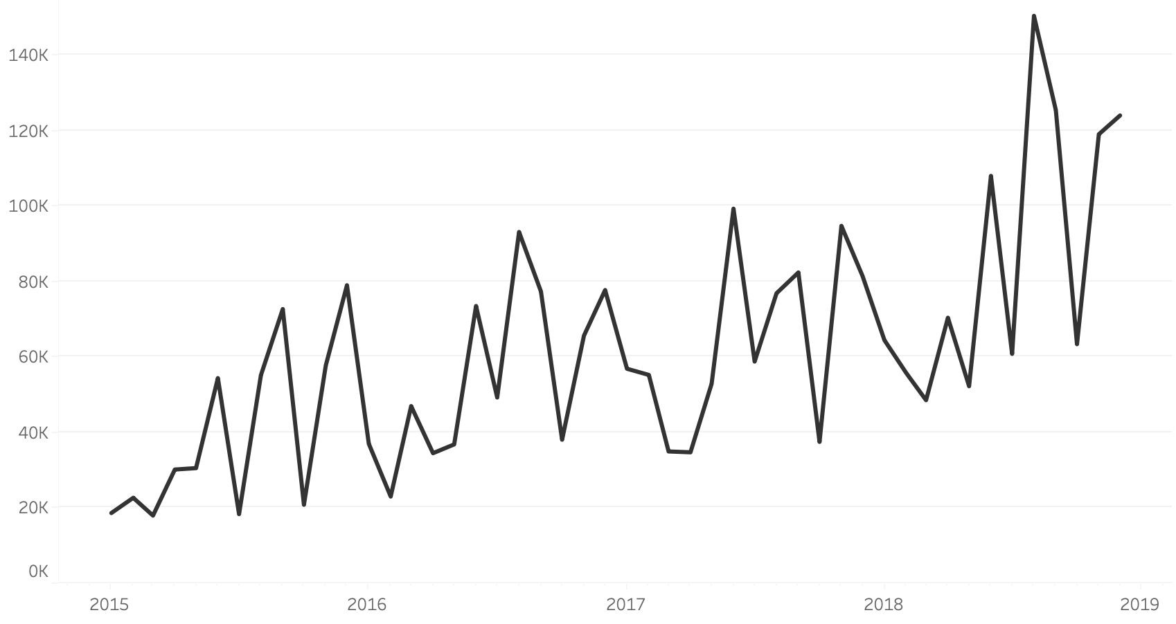
Hands-on: Dates
Exercise 6: The ﬁrm wants to investigate the seasonal pattern and the overall trend in sold quantity
Step by step:
Open a new sheet
Create a bar chart showing the monthly seasonal pattern
Step by step:
Open a new sheet
Create a continuous timeline showing the monthly trend in sales
Change the axis to years and remove the axis title
Discrete / Sæson mønster
Continuous / Trend

Slide 37
Businesscasen – Hvad skal vi annalysere?
Date | Ship Date | Ship Mode | Product ID | Customer ID
07.02.2018 | 11.02.2018 | Standard Class | 10000988 | AS-10045
Customer Name | Segment | City | State | Country | Region
Aaron Smayling | Corporate | Leeds | England | United Kingdom | North
Category | Sub-Category | Product Name
Office Supplies | Storage | Fellowes Folders, Blue
Sales | Quantity | Discount | Profit
79,2 | 3 | 0 | 39,6

Slide 38


Map
Usage
Show geographic positions on a map
Copenhagen, DK
(55,7;12,6)
Good to know
Use mapbox to create custom maps
41
Notes:
Tableau kan genkende byer i DK ned til omkring 20.000 indbyggere

Slide 39

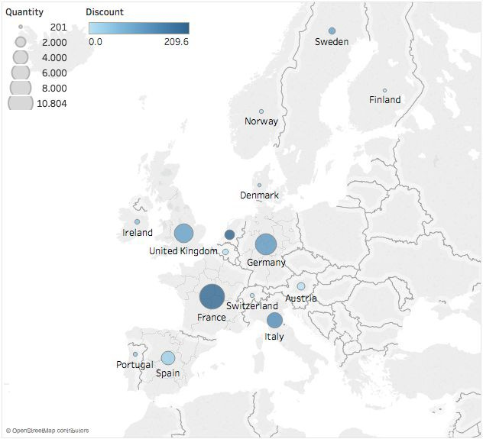
Hands-on: Maps
Exercise 7.1: Do people buy more when discount is higher?
Step by step:
Open a new sheet
Create a map with countries and label them
The size should illustrate the Quantity
sold
The colour should illustrate the
Discount
Sæt farven så man kan forstå at en stor rabat ikke nødvendigvis er godt.
Notes:
Man trækker landet/byen ind på midten af sheetet og slipper. Ikke op i kolonner/rækker, så får man bare en tabel

Slide 40

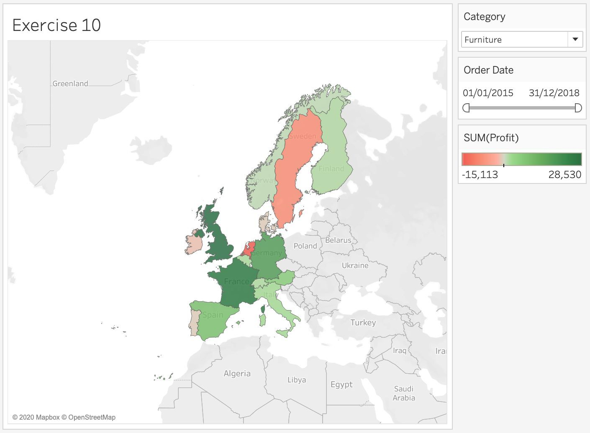
Hands-on: Filter, date and map
Exercise 7.2: Which countries generate the highest proﬁt within a given time period and category?
Step by step:
Open a new sheet
Create a ﬁlled map on Countries
Colour on Proﬁt and use the
red-green diverging scale
Create a date ﬁlter with a slider and a
Category ﬁlter drop-down

Slide 41

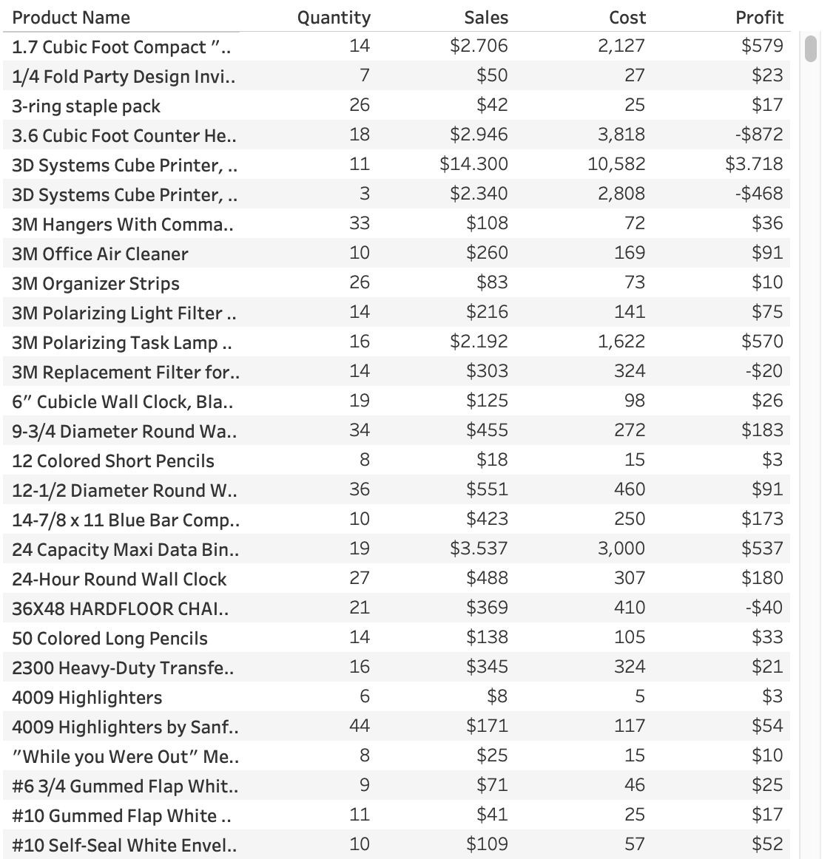
Hands-on: Table
Exercise 8: Create a table with multiple measures
Step by step:
Open a new sheet
Create a table showing a list of all products
Use the Measure values (Quantity, Sales, Proﬁt (*and Cost ))
(*Hint: Use Show me)

Slide 42
Hands-on: Table
Exercise 8: Create a table with multiple measures
Step by step:
Open a new sheet
Create a table showing a list of all products
(*Hint: Use Show me)

Slide 43
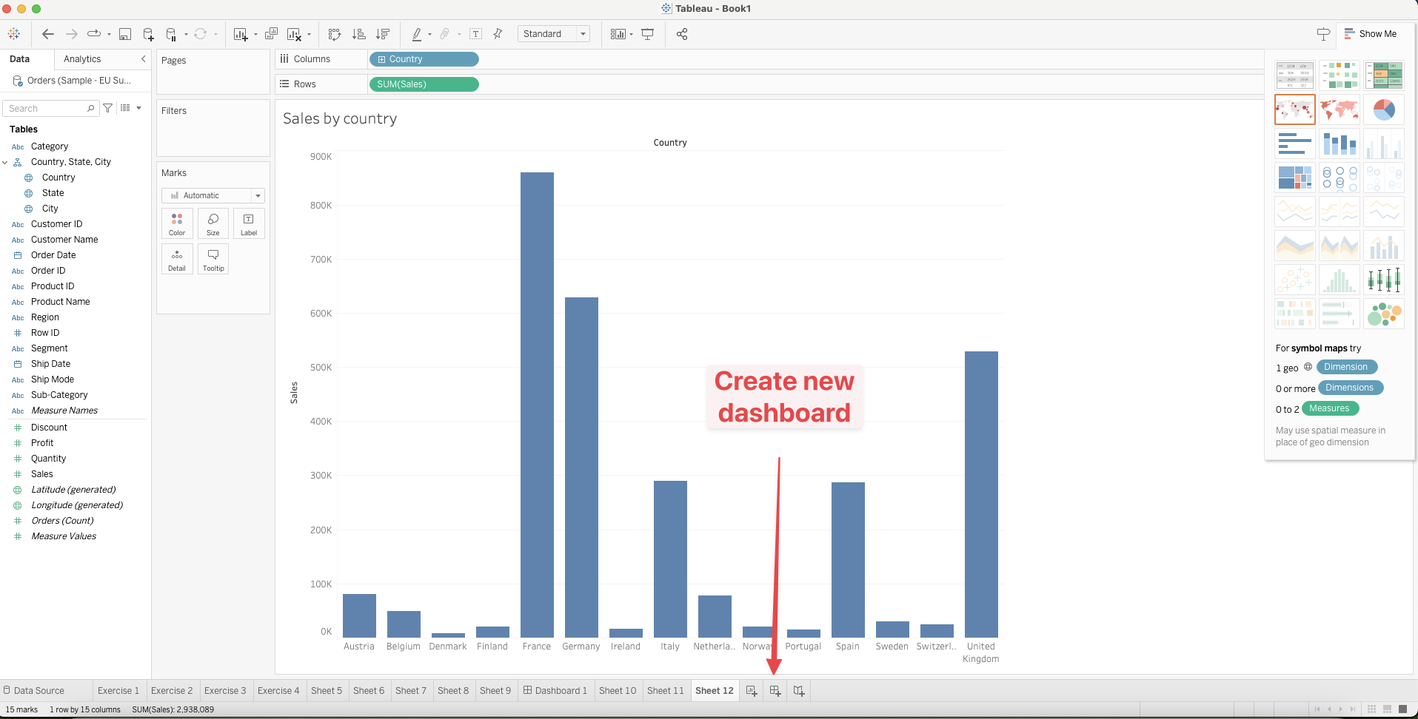
Interface – Create Dashboard

Slide 44
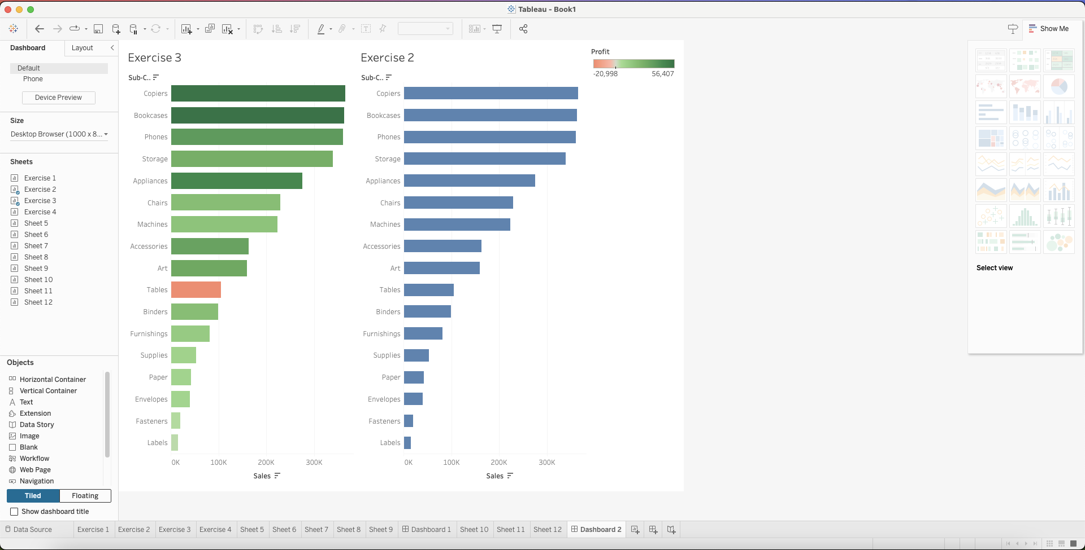
Interface – Dashboard

Slide 45

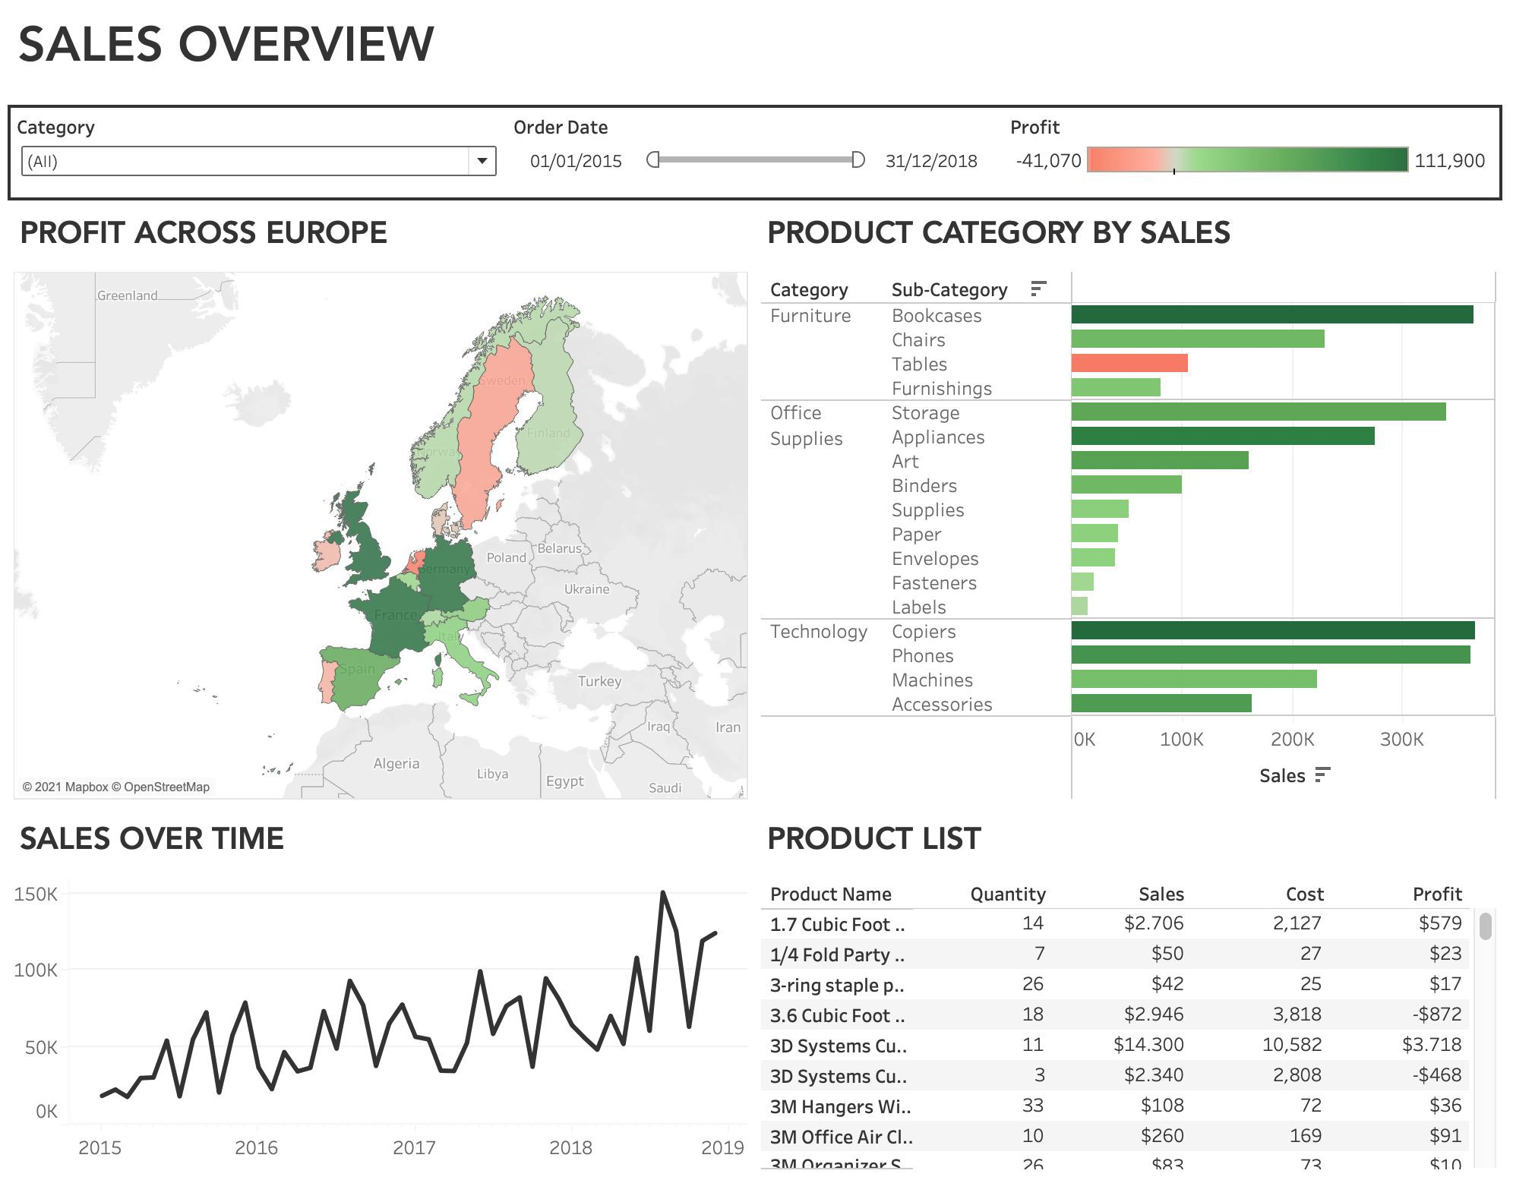
Hands-on: Dashboard
Exercise 9: Create your own sales superstore dashboard
Step by step:
Use the sheets you have created and drag them into your dashboard
Proﬁt across countries (map)
Sales across Category and
Sub-category (bar chart)
Sales over time (line chart)
Product list (table)
Create a title (font: Avenir)
Place all ﬁlters and legends in a container

Slide 46

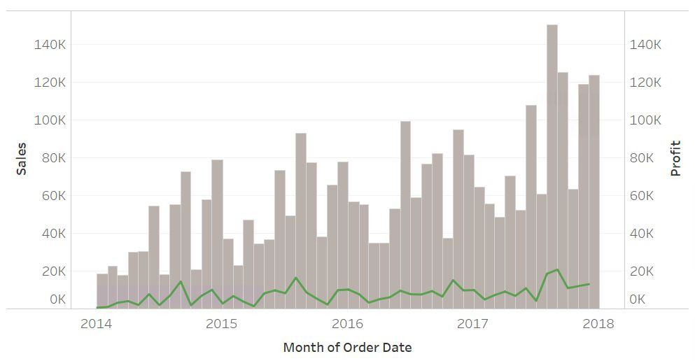
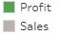
Hands-on: Multiple ﬁelds
Exercise 8: Is the proﬁt driven by sales over time?
Step by step:
Open a new sheet
Show Sales over continuous months
In the same graph, add Proﬁt to rows
Create a dual axis and synchronize
Format chart type and adjust colours

Slide 47
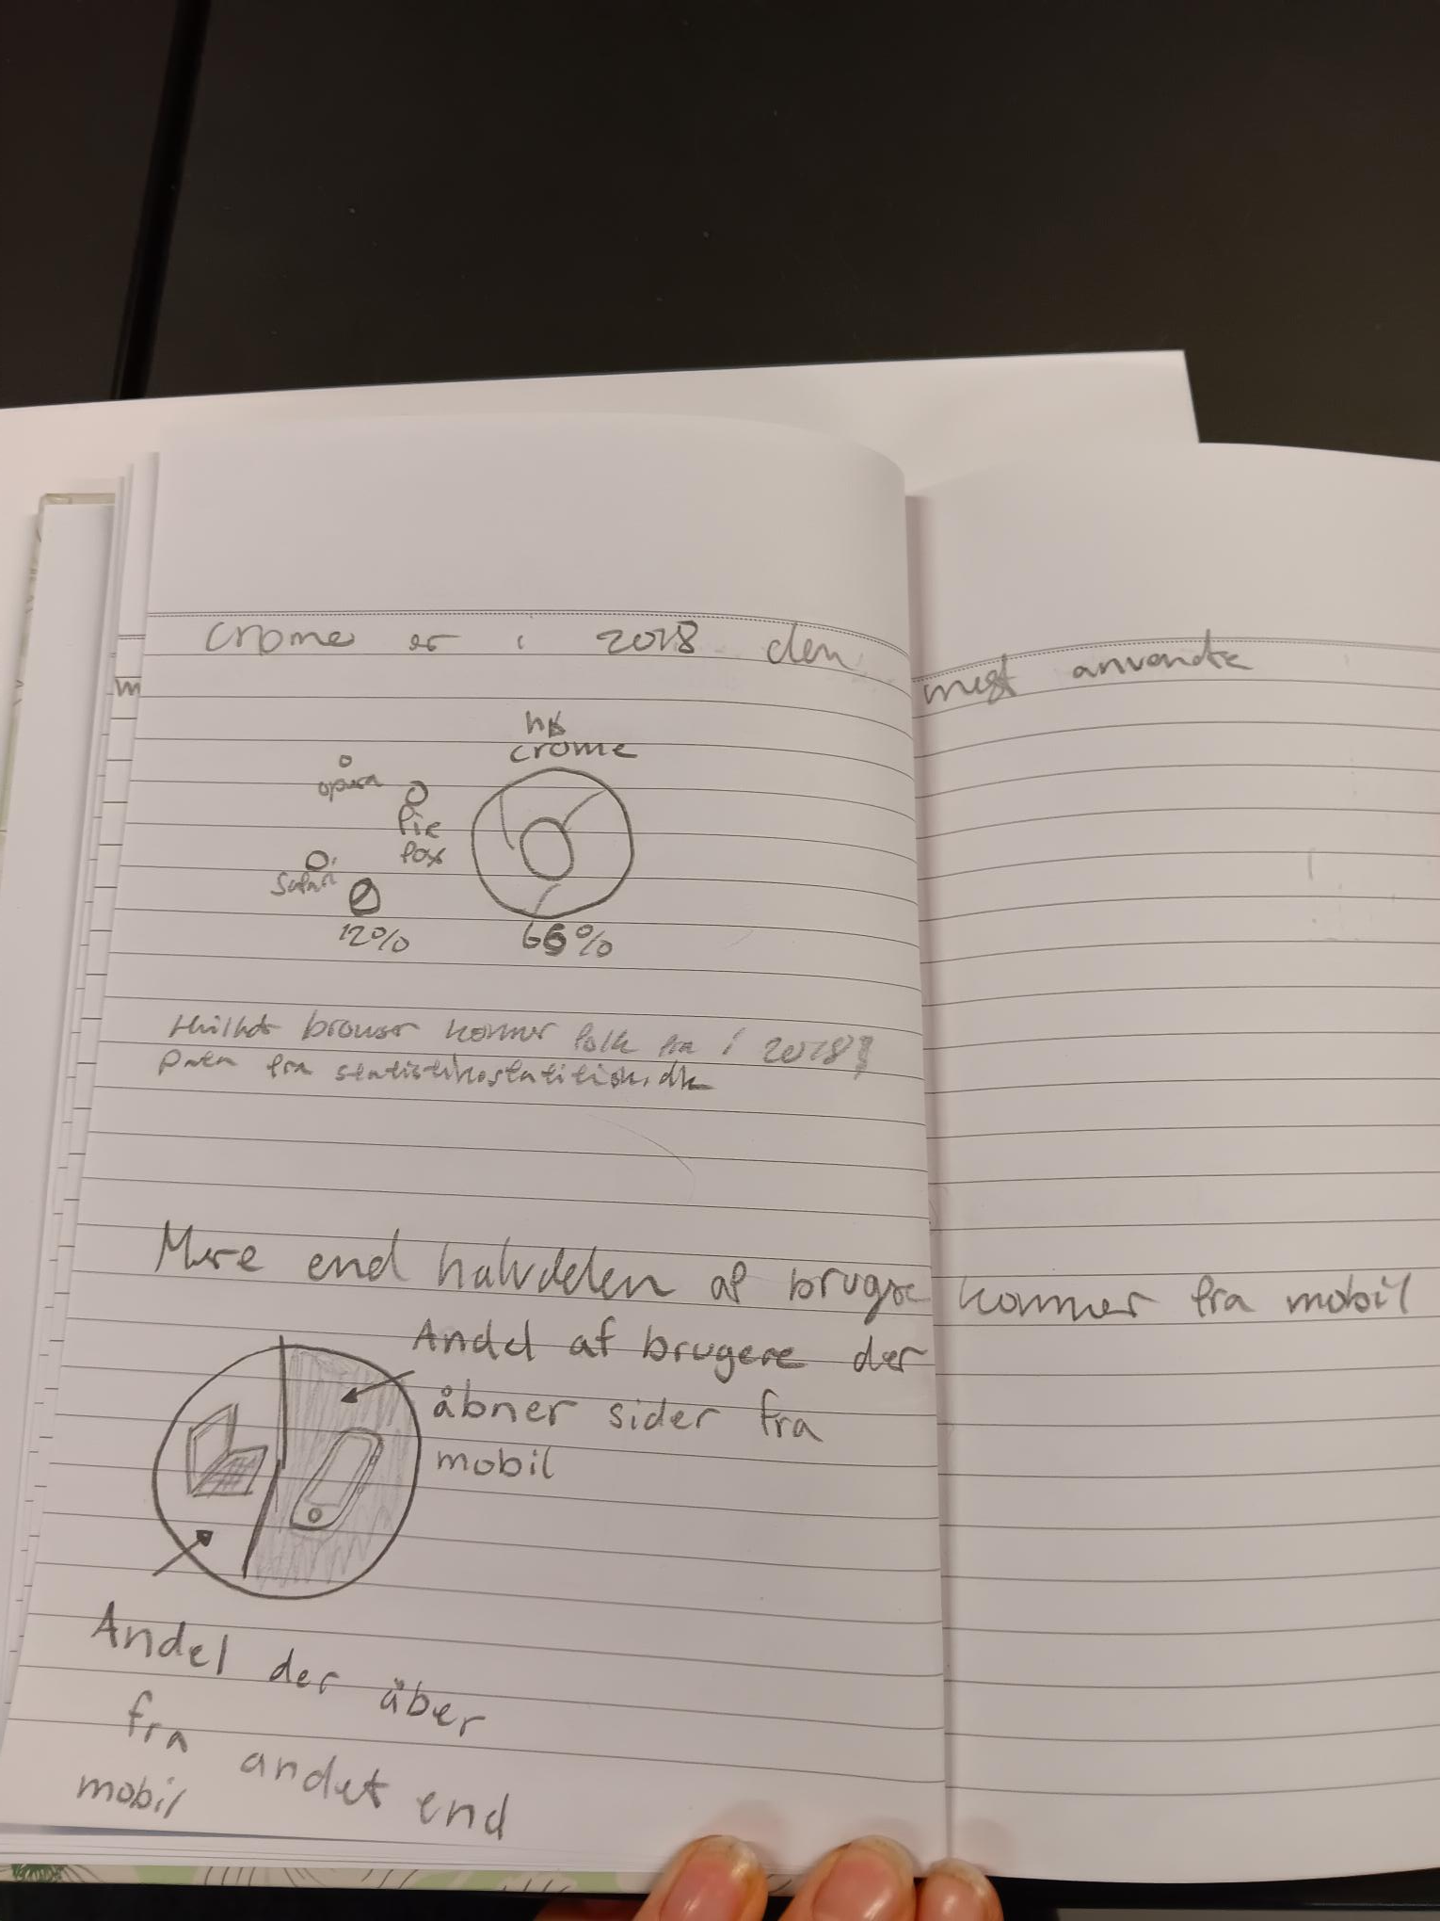
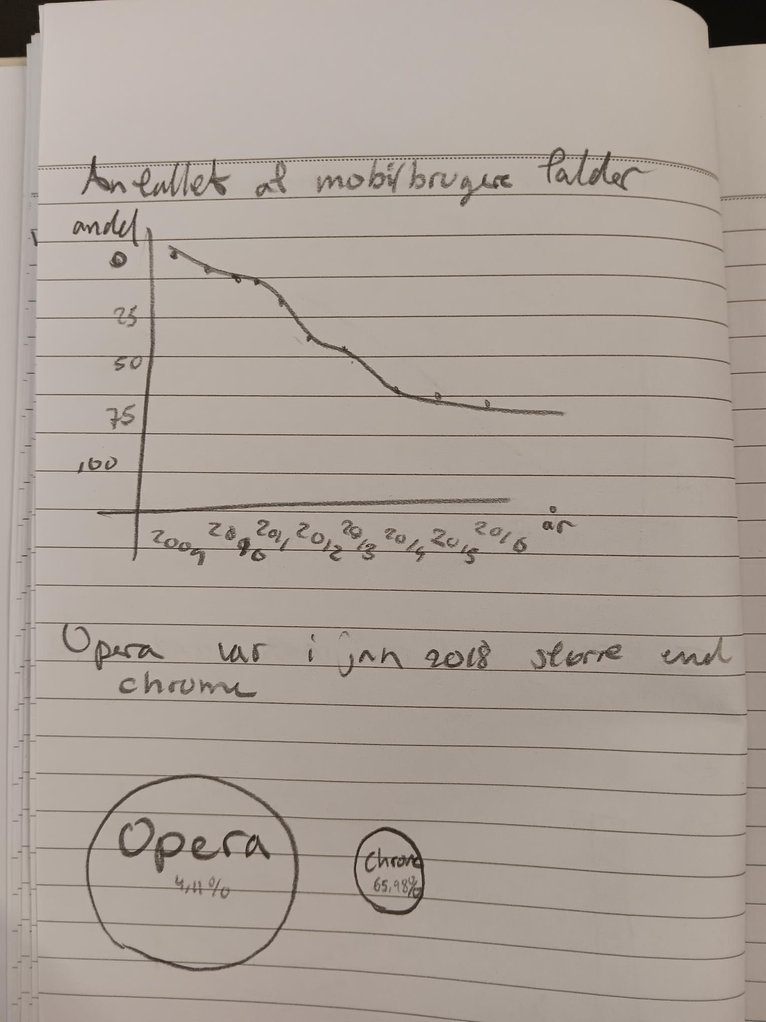
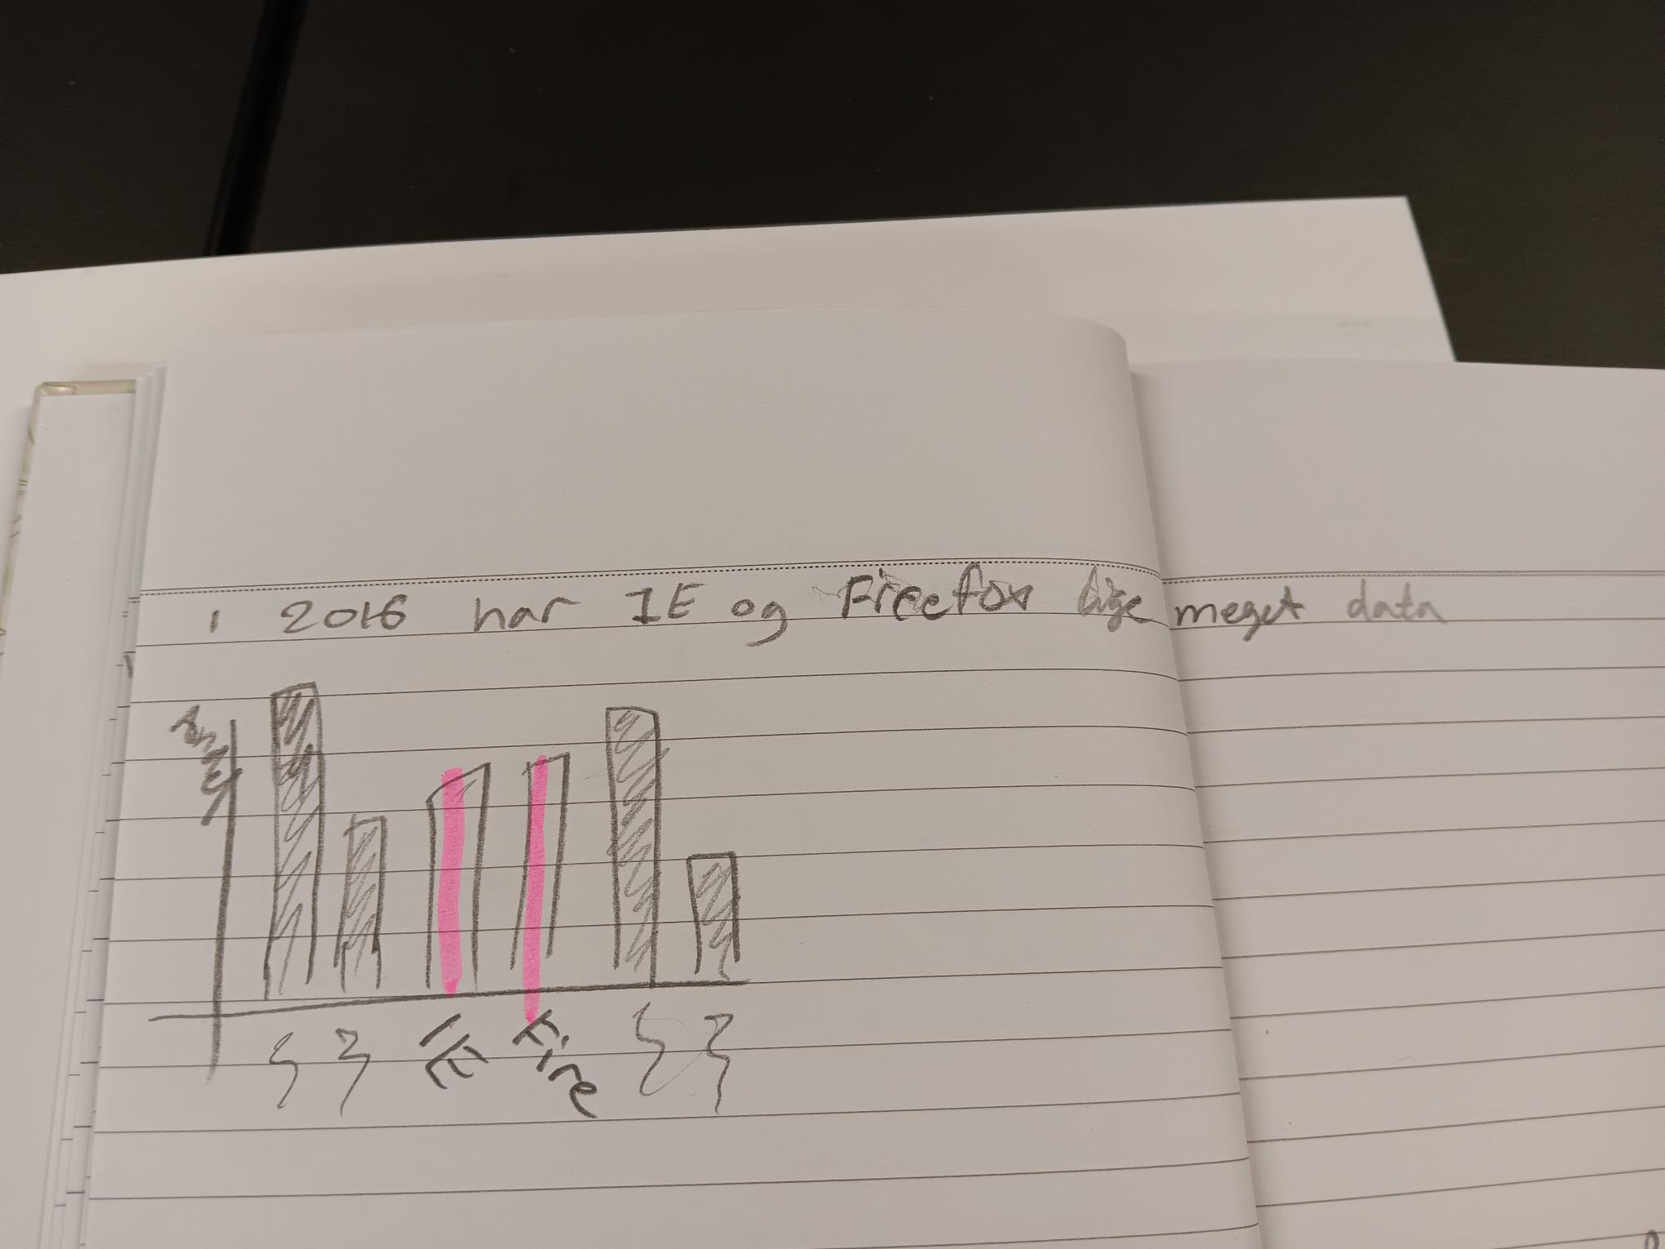
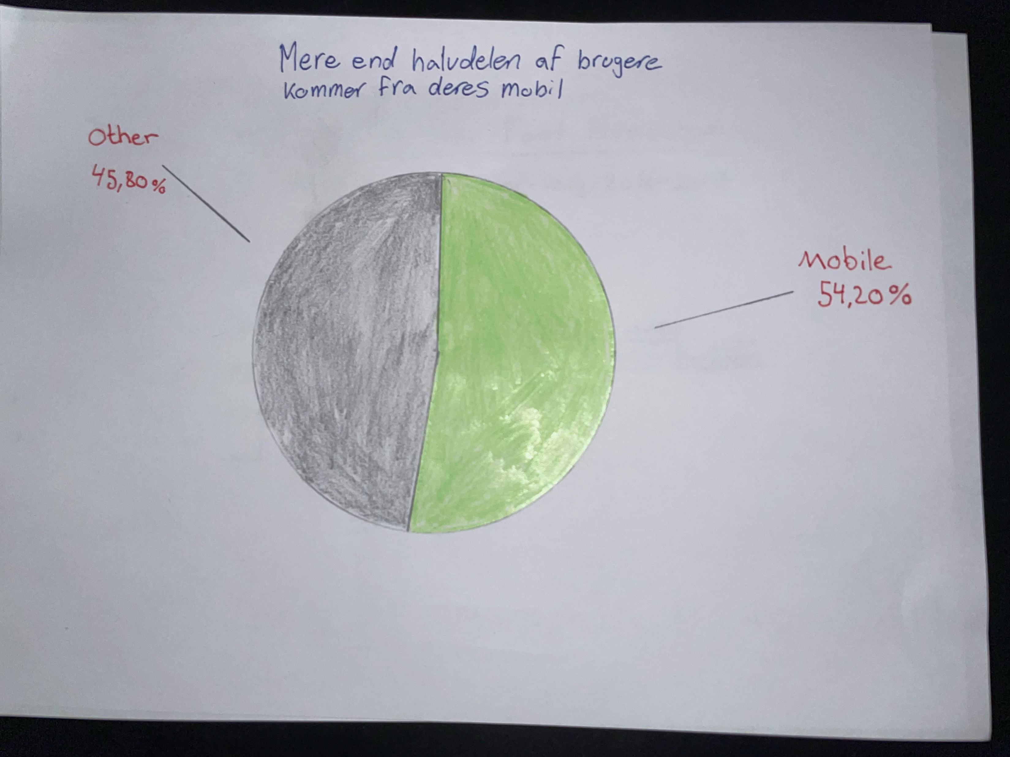
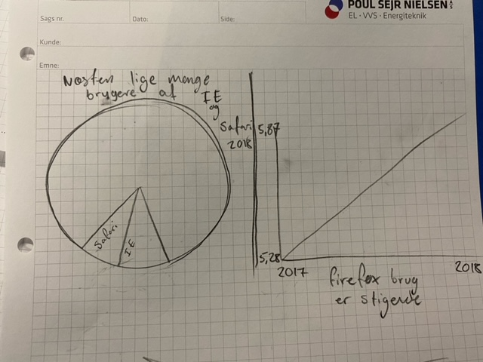
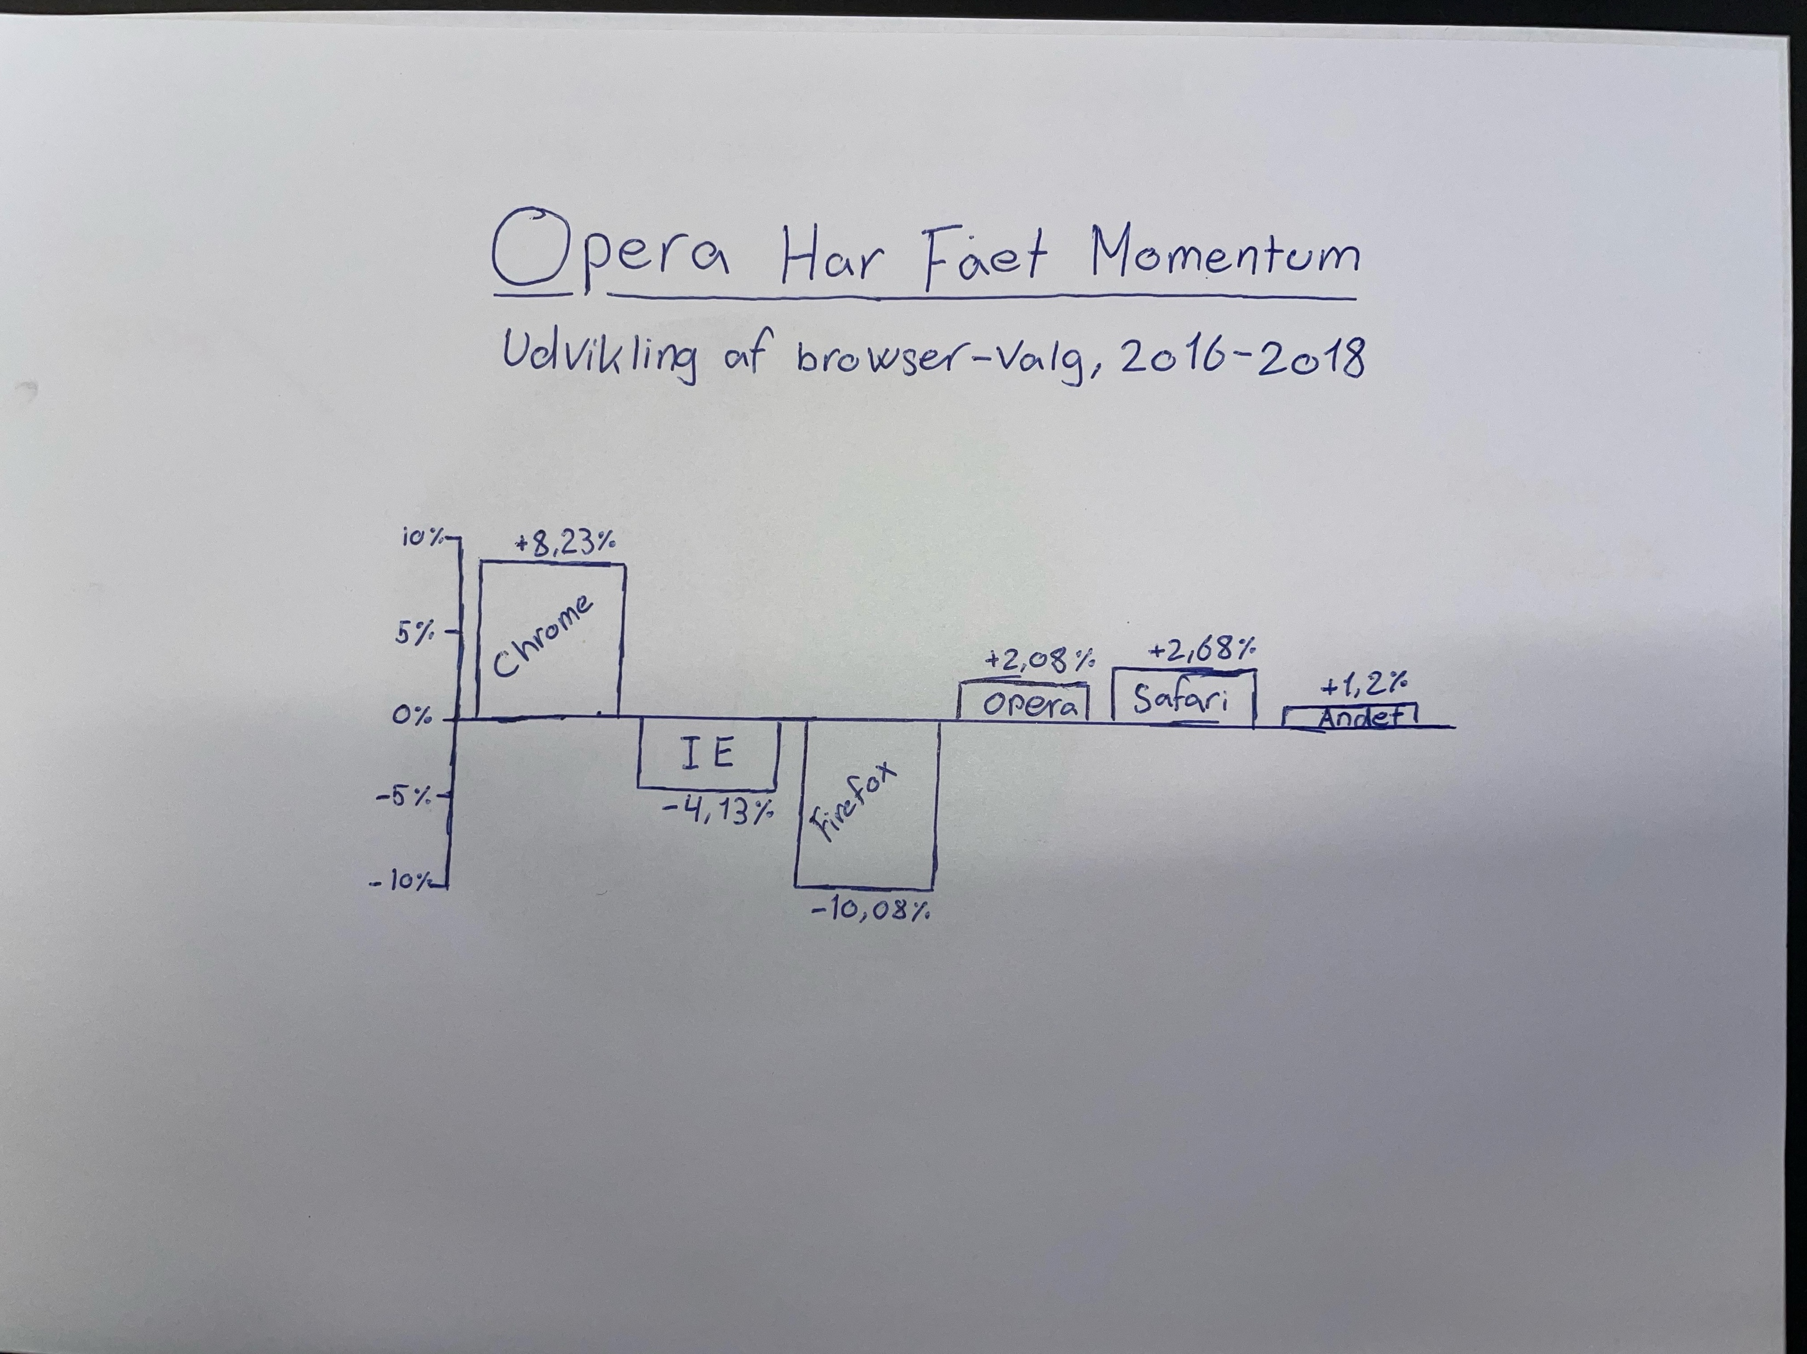
Hands-on: Table
Exercise 9.1: Recreate 3 visualisations you have made before

Slide 48
Agenda
Introduction to the training & tableau
Connect to data
Basic visualizations
Filtering, dates & maps
Dashboards
Join databases
Recap of the day

Slide 49
Ekstra
Excel
Forbinde tabeller i Tableau

Slide 50
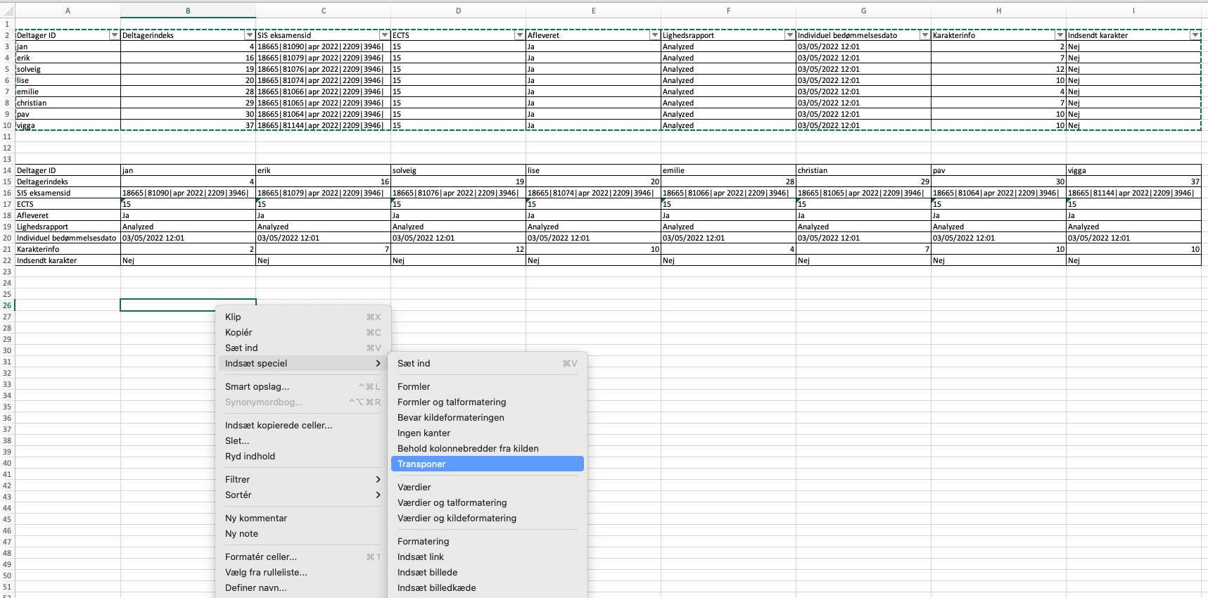
Flip Tabeller i Excel
Brug funktionen
“Indsæt Speciel” / “Transponer”

Slide 51
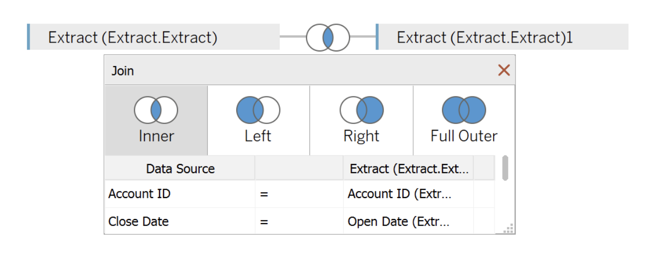
Joins i Tableau
Notes:
Source: https://onenumber.biz/blog-1/2018/12/16/when-would-you-want-to-join-a-table-to-itself

Slide 52
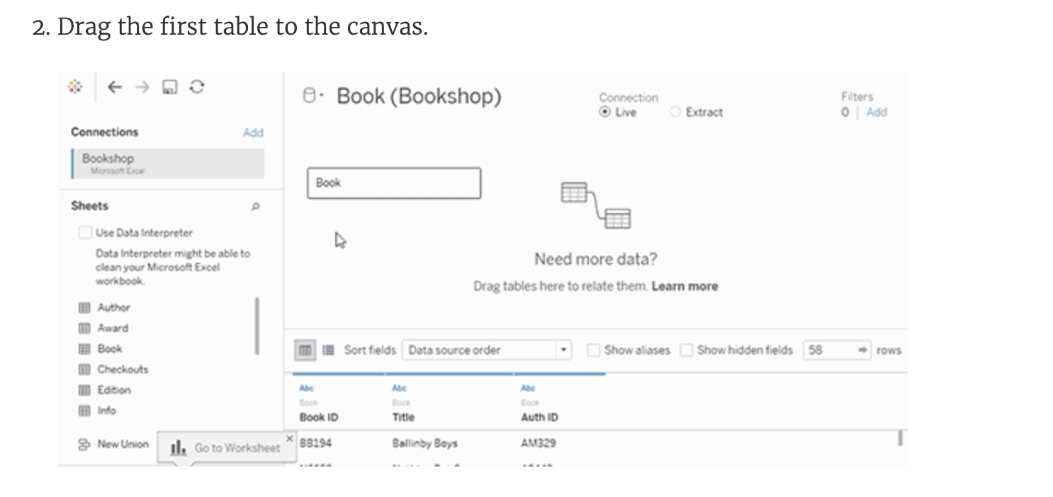
RELATIONSSHIP or JOIN or BLEND
Notes:
Blend:
Source: https://help.tableau.com/current/pro/desktop/en-us/multiple_connections.htm
Relationships:
https://help.tableau.com/current/pro/desktop/en-us/joining_tables.htm

Slide 53
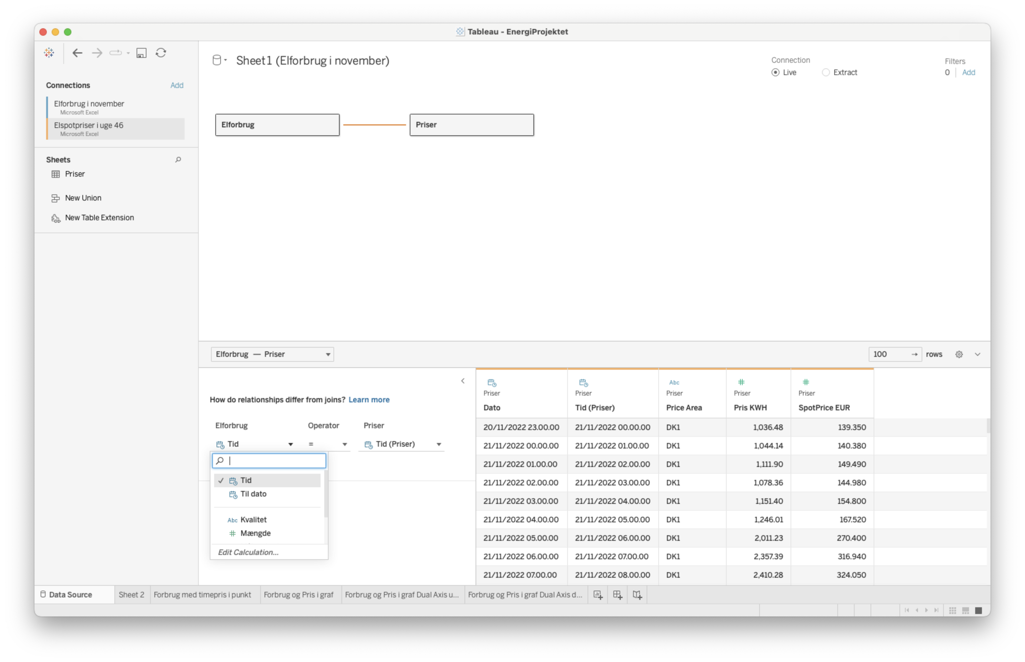
Binde Tabeller sammen

Slide 54
Agenda
Introduction to the training & tableau
Connect to data
Basic visualizations
Filtering, dates & maps
Dashboards
Join databases
Recap of the day

Slide 55
Opsummering
Bar chart
Usage: Good at comparing categories and numbers. one of the most used visualizations.
Line chart
Usage: Good for continuous data and when looking at trend seasonality over time.
Table
Usage: Good at comparing numbers if you want to ass lots of information. Note: if too big, it can be confusing.
Filter
Usage: If you only want to look at a part of your data at a time but the user should have the possibility to choose which part.
Dates
Usage: Look at trends, seasonality or YTD KPI’s.
Area map
Usage: Good at comparing geographical locations and looking into geographical patterns.

Slide 56



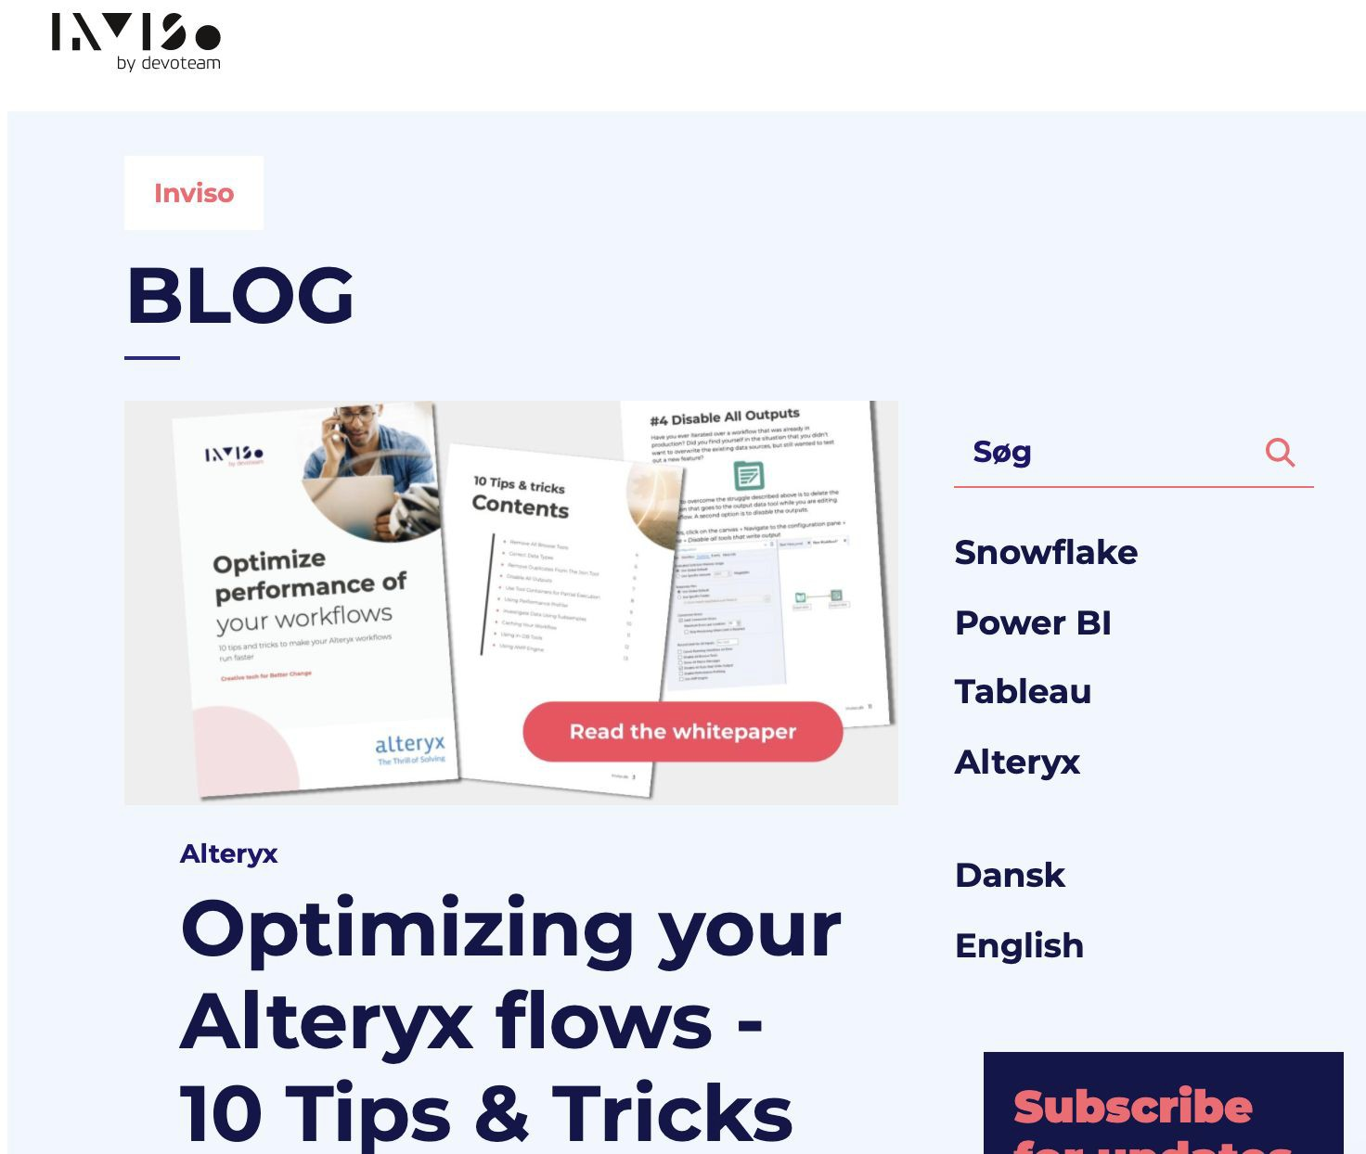


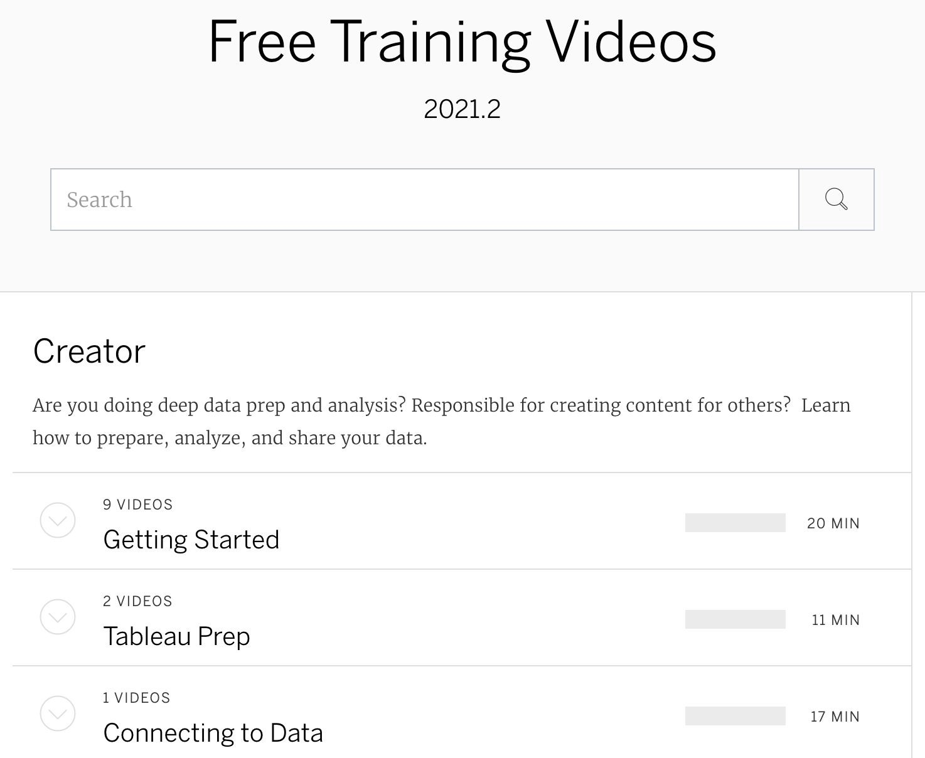





Where to ﬁnd more knowledge?
Public Gallery
See work from others
Showcase your own work
The usual suspects...
Inviso.dk, Blogs, YouTube..
Tableau.com
Forum, Q&A’s
Free training videos, whitepapers
Click for link
Notes:
Source: https://www.tableau.com/learn/articles/data-visualization-tips

Slide 57
DEL 2

Slide 58

1
Inspiration
Descriptive analysis
Basic visualisations (bar chart, line chart, etc.)
Tableau
courses
2
Intermediate
Parameters
Advanced visualisations (Combined axis, totals etc.)
3a
Calculations
Level of detail calculations
Table calculations
3b
Visual best practice
Dashboard design
Visual best practices

Slide 59

1
Inspiration
Data blending
Preparation
Alteryx
courses
2
Intermediate
Join, union and append data
Data parsing and calculations
3a
Macros
Introduction to macros
Application programming interface
Alteryx gallery
3b
Predictive
Statistical models
Model comparison and best practice

Slide 60

If time
Extra topics and exercises

Slide 61


Hands-on: Reference lines
Exercise: Which product sales are below category average?
Step by step:
Open a new sheet
Create a bar chart with Category, Sub-Category and Sales
Create a reference line showing the average within the Category
Format the line: Show the value and colour it red

Slide 62


Hands-on: Group
Exercise: We want to look at all paper articles together
Step by step:
Open a new sheet
Create a view showing Sales per
Sub-Category and Category
Group the following Sub-Categories
together: label, envelopes and paper
Edit the alias to a meaningful name (e.g. Paper articles)
Bring both the new and the old
Sub-Category to the view

Slide 63
Measure names and measures values
Auto-generated ﬁelds
ABC
#
Measure names
Contains all the names of your measures in your data. Is used to split your measure values to individual measures.
Measure values
Contains all the measures in your data collected to one single ﬁeld. If no measure names is added to your view it will sum all the values of your measures.
Why? → Useful to build views involving multiple measures

Slide 64


Hands-on: Multiple ﬁelds
Exercise: How are sales, proﬁt and quantity over time?
Step by step:
Open a new sheet
Create a bar chart of average
Discount by continuous quarters
Create a dual axis also showing Sales
and Proﬁt
Format the colours

Slide 65

Thank you.
Benjamin

